Slide 1
Building AI Agents with LangChain
March 2025 Workshop
Dipanjan (DJ) Sarkar

Slide 2
Workshop Guidelines
Assumptions: Python essentials is necessary (LangChain - good to have)
Session will cover concepts and hands-on code demos
Please type your questions in the chat \ QA tab
Will address questions at regular intervals + at the end
Please ask queries related to today’s session only
Queries on other issues, access problems, course issues etc reach out to the support team
Each workshop will be repeated per quarter over the year
Slides, notebook links, recording will be uploaded and shared in the LMS by next week
Use the workshops to augment and supplement your learning, not as a replacement of the courses in the program

Slide 3
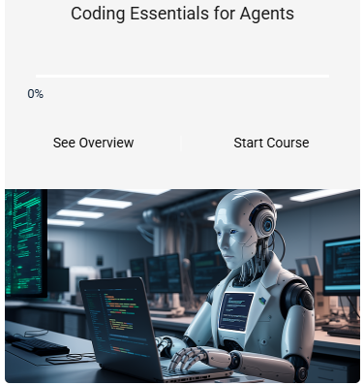
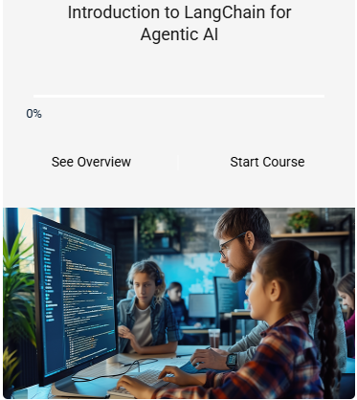
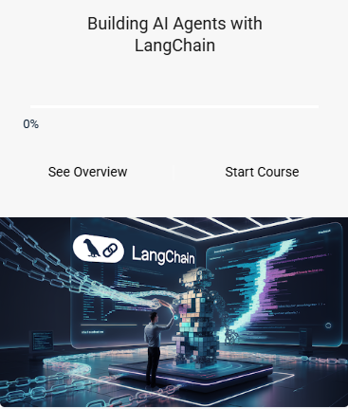
Useful Courses to go through

Slide 4
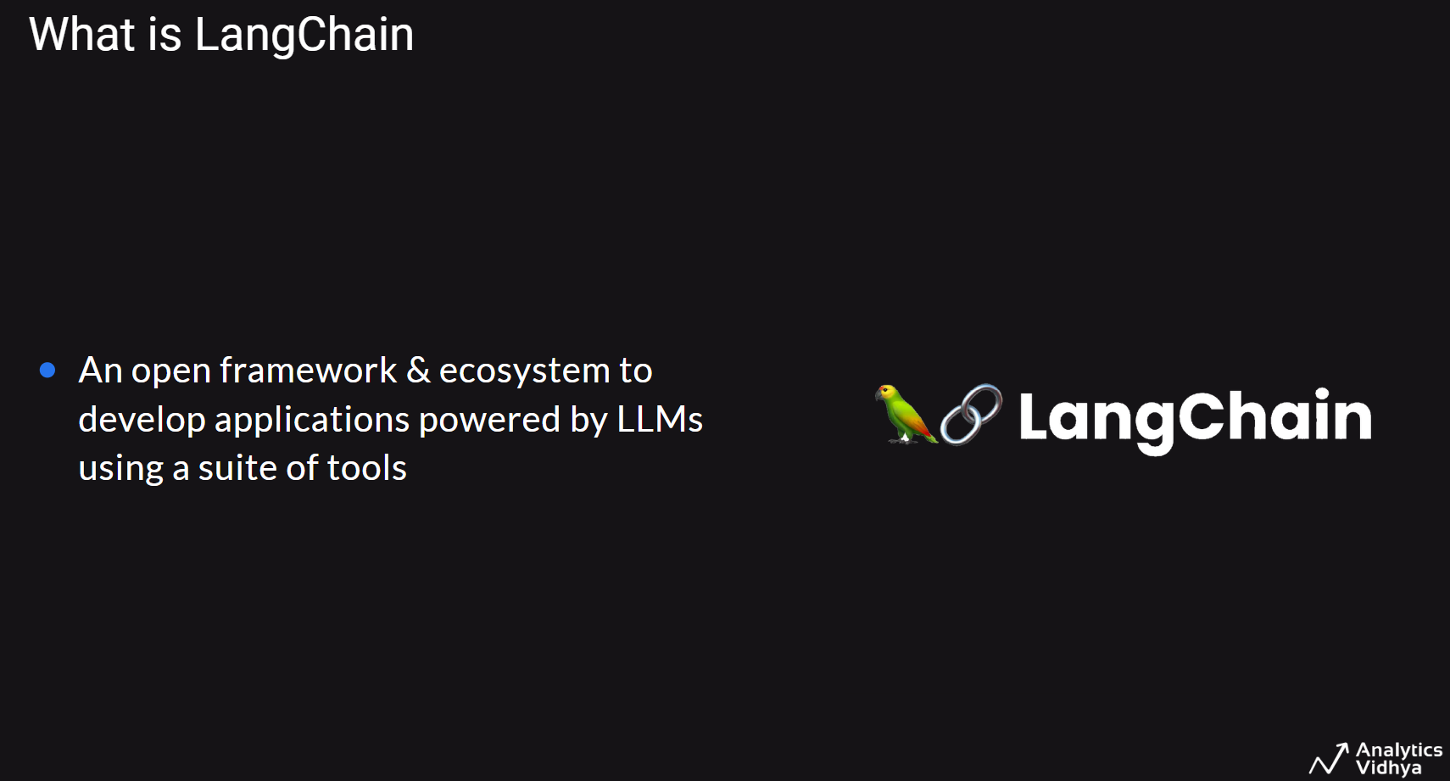

Slide 5
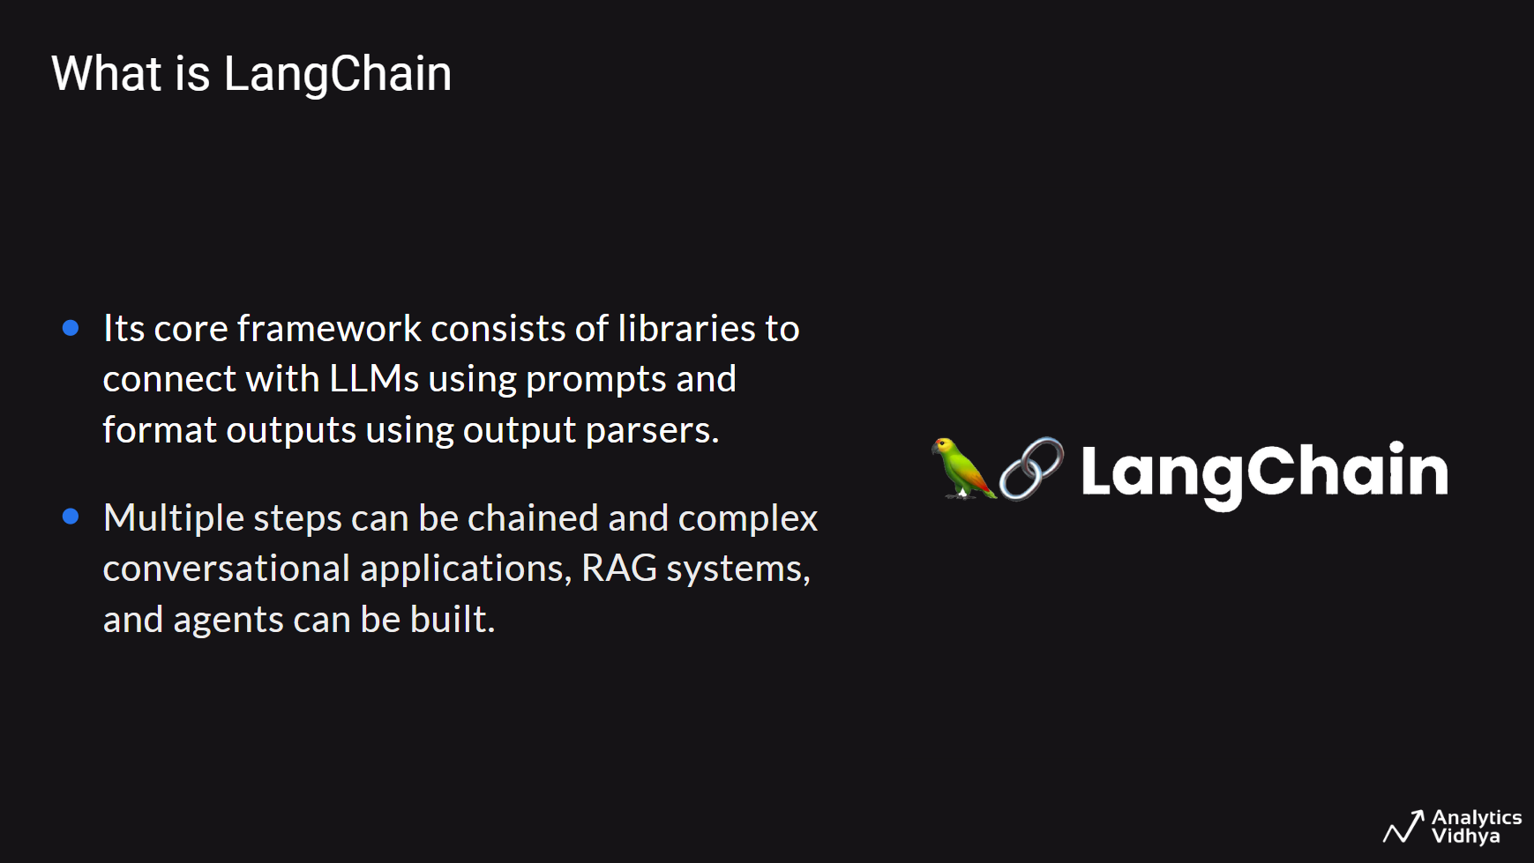

Slide 6
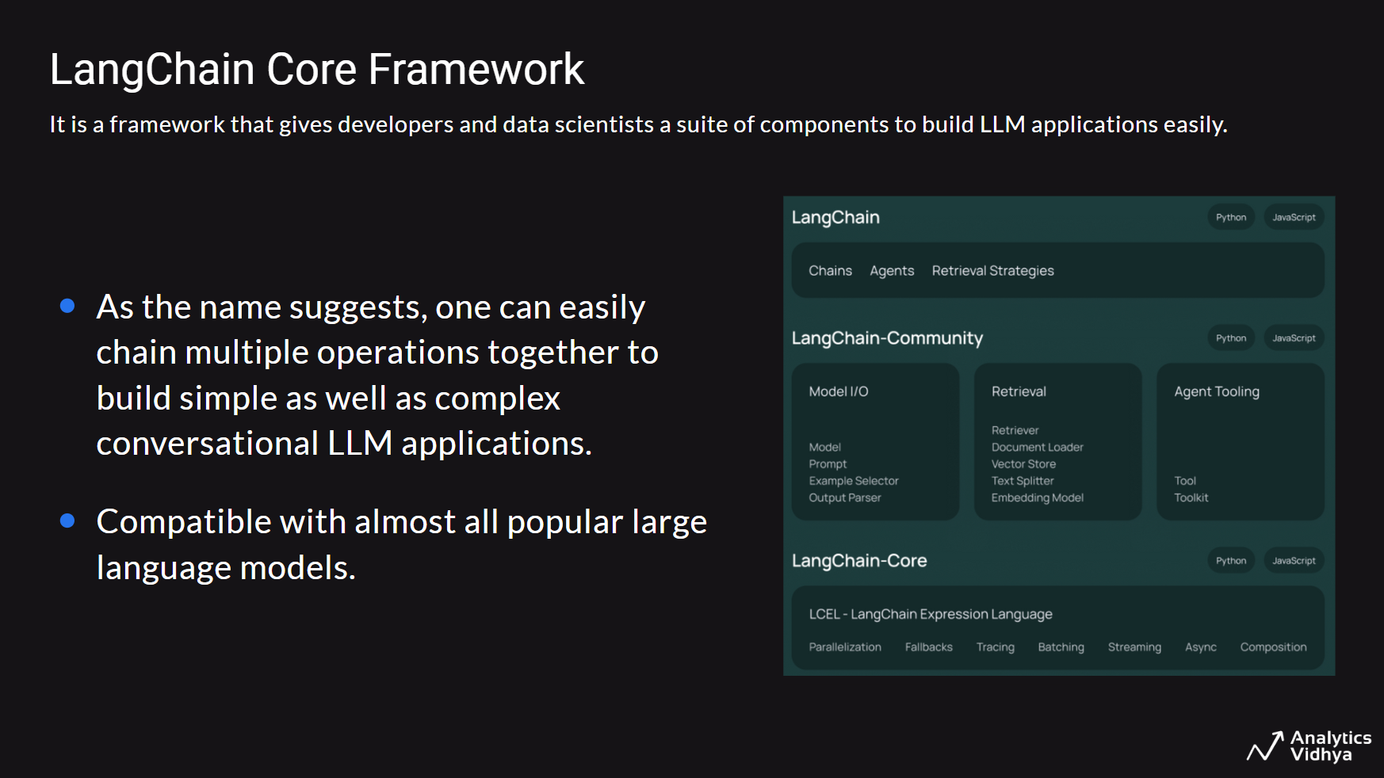

Slide 7
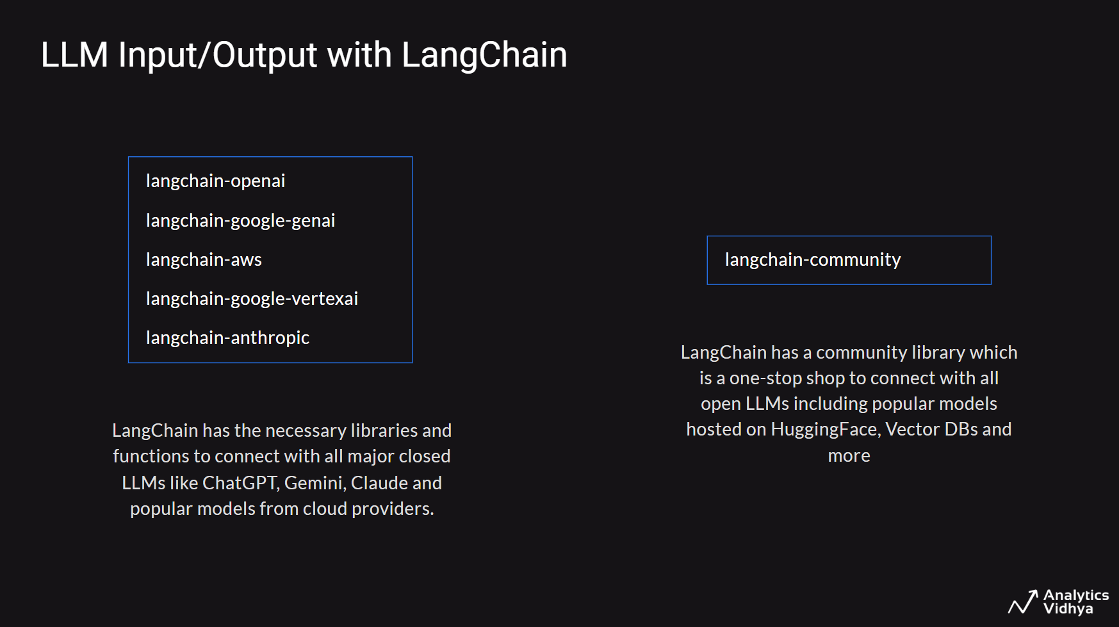

Slide 8
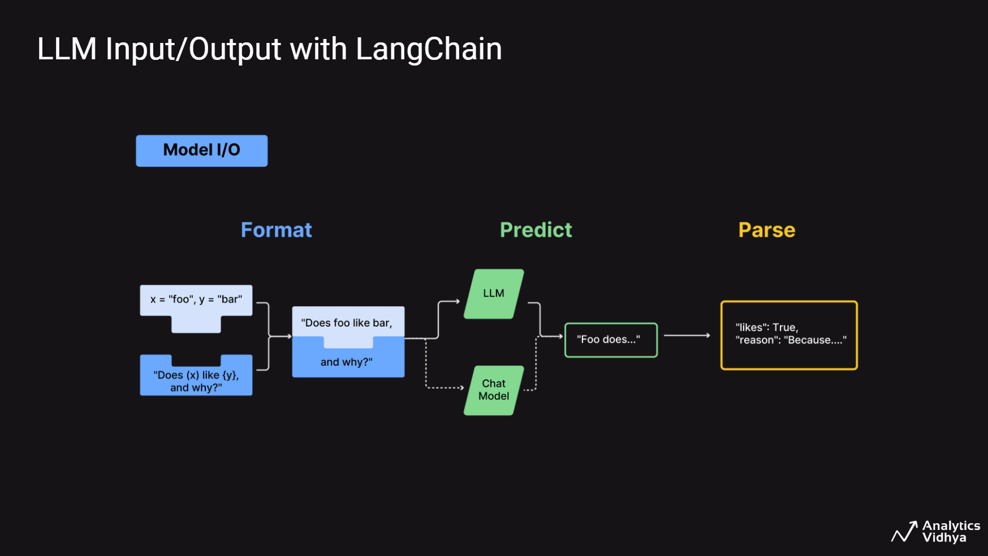

Slide 9
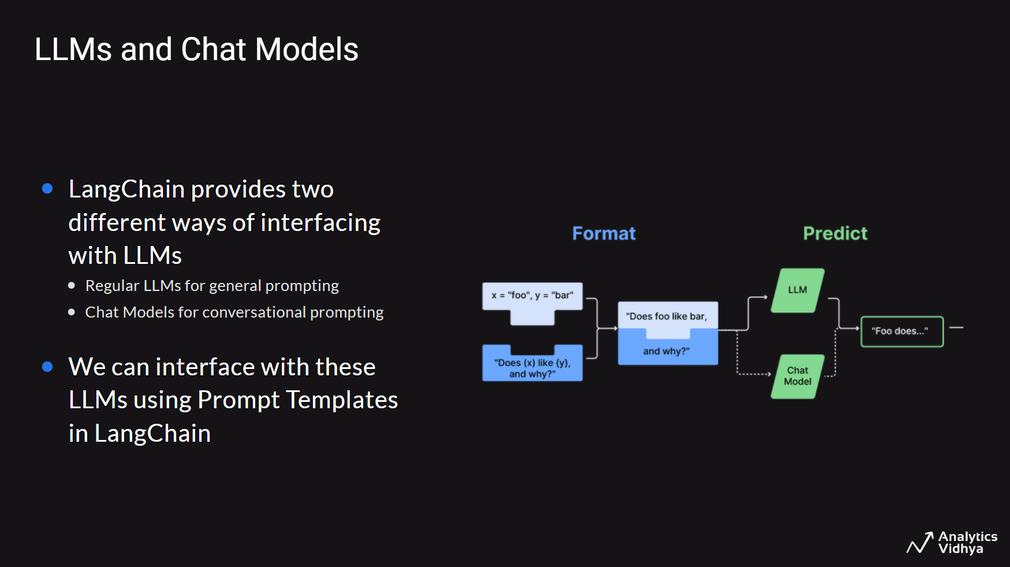

Slide 10
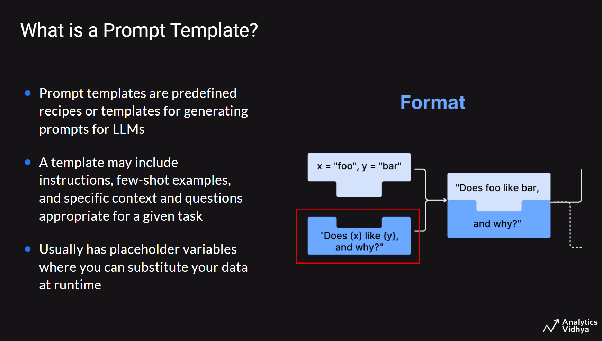

Slide 11
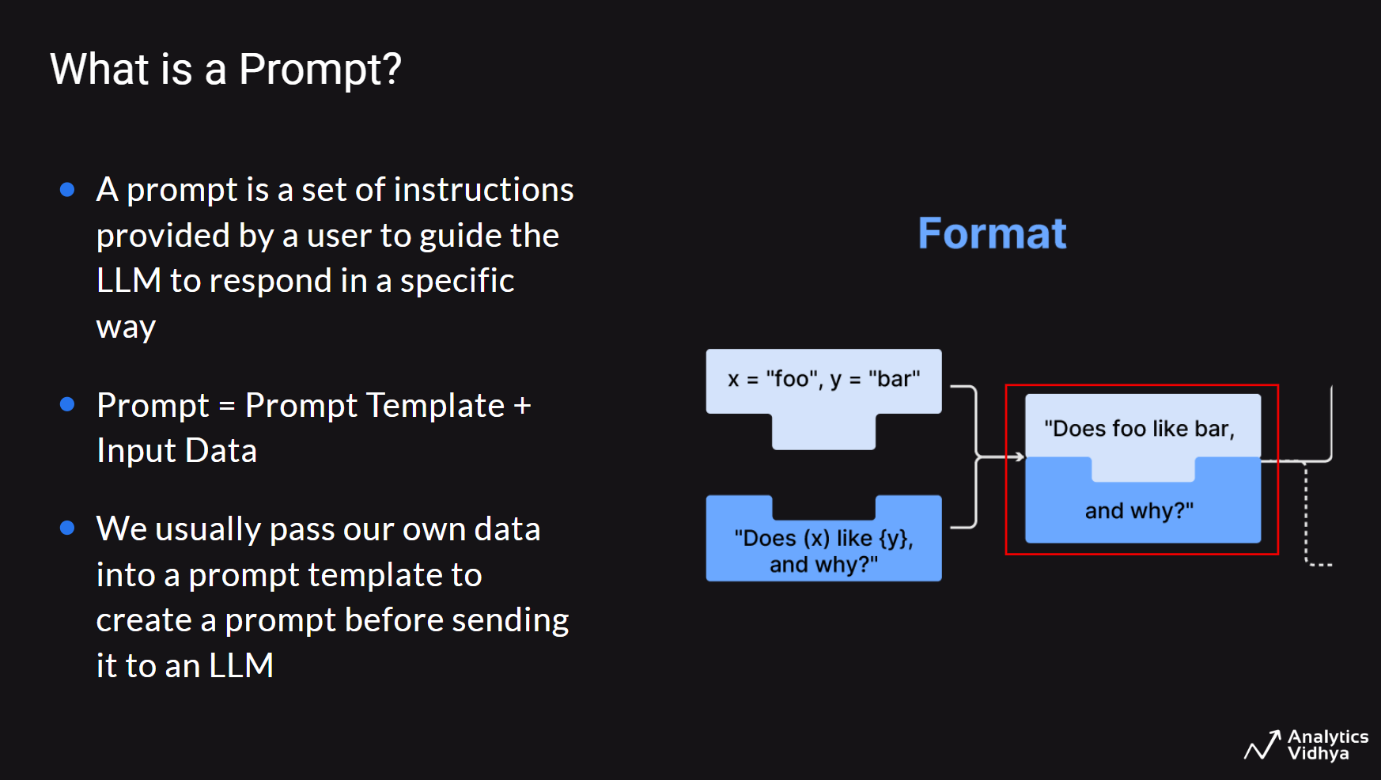

Slide 12
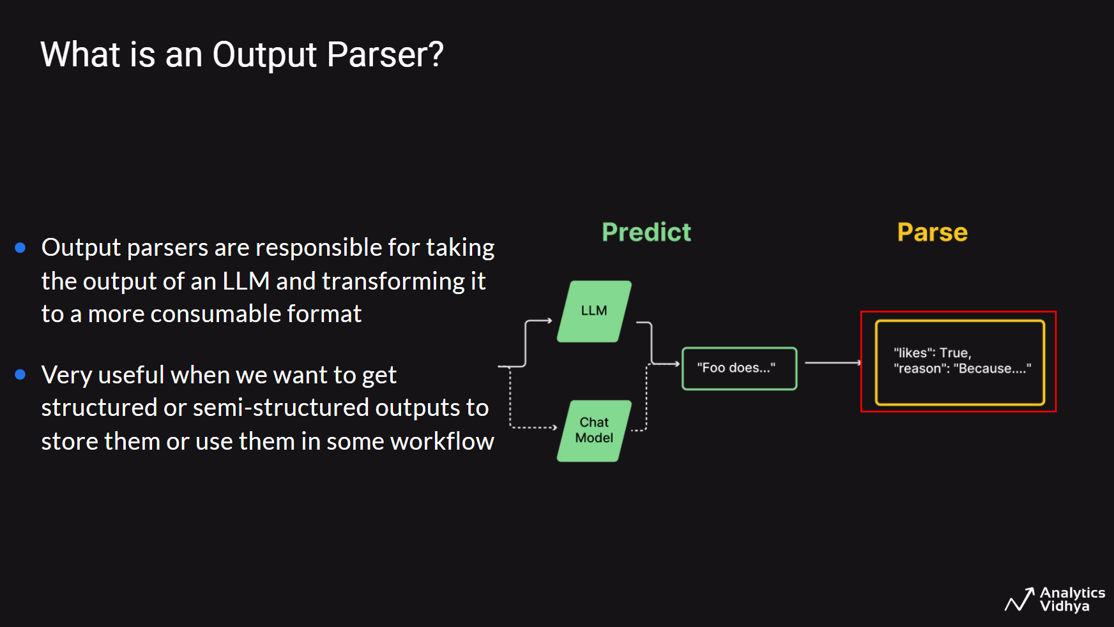

Slide 13
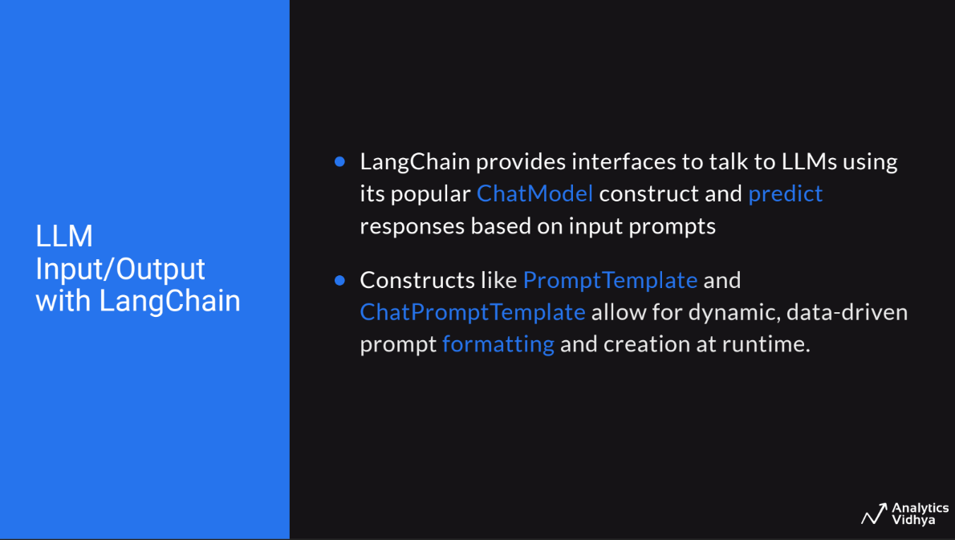

Slide 14
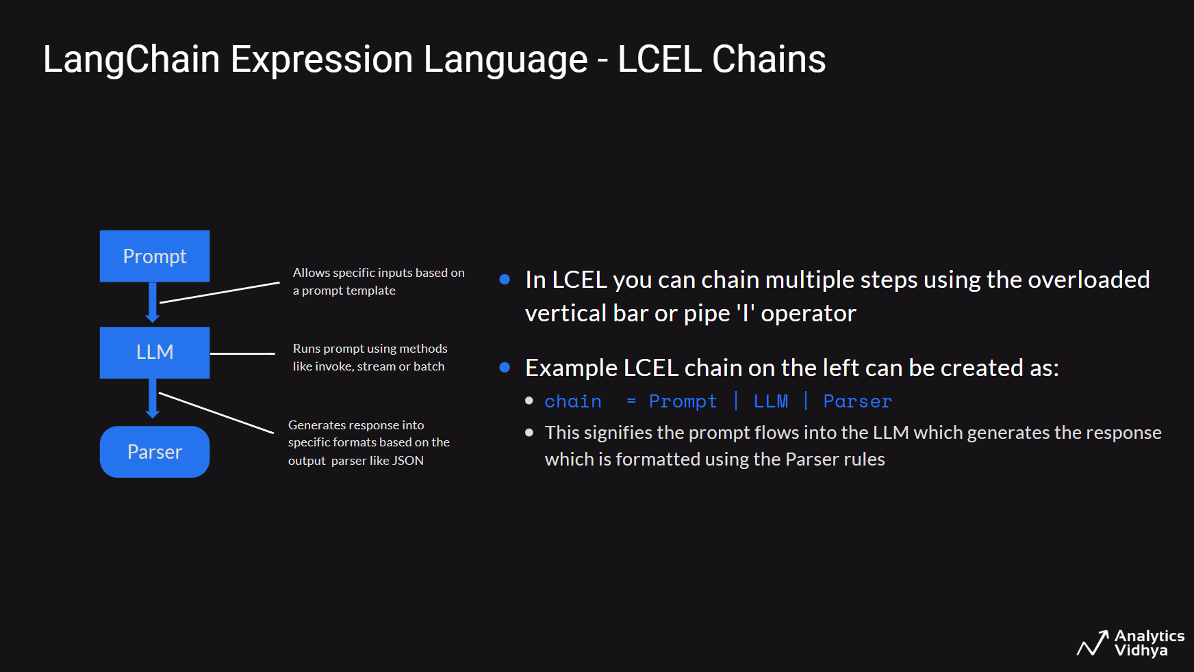

Slide 15
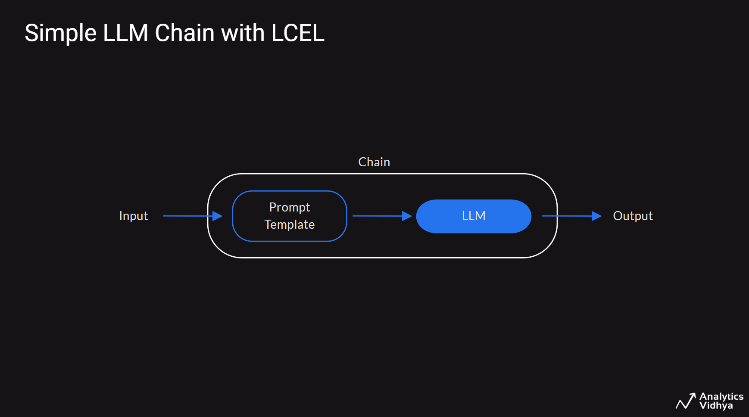

Slide 16
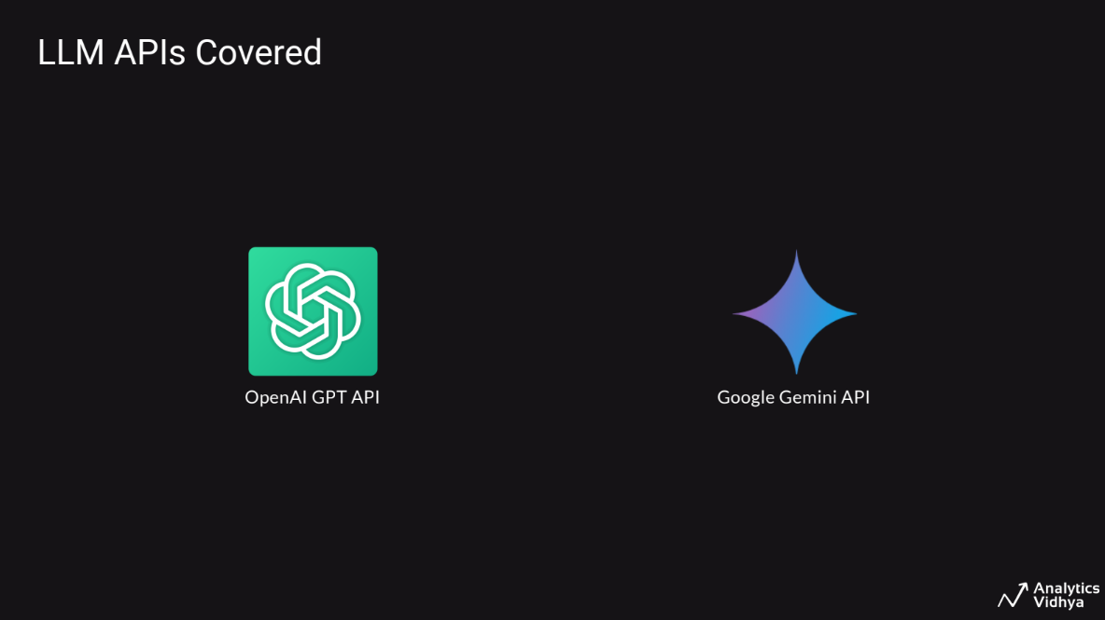

Slide 17
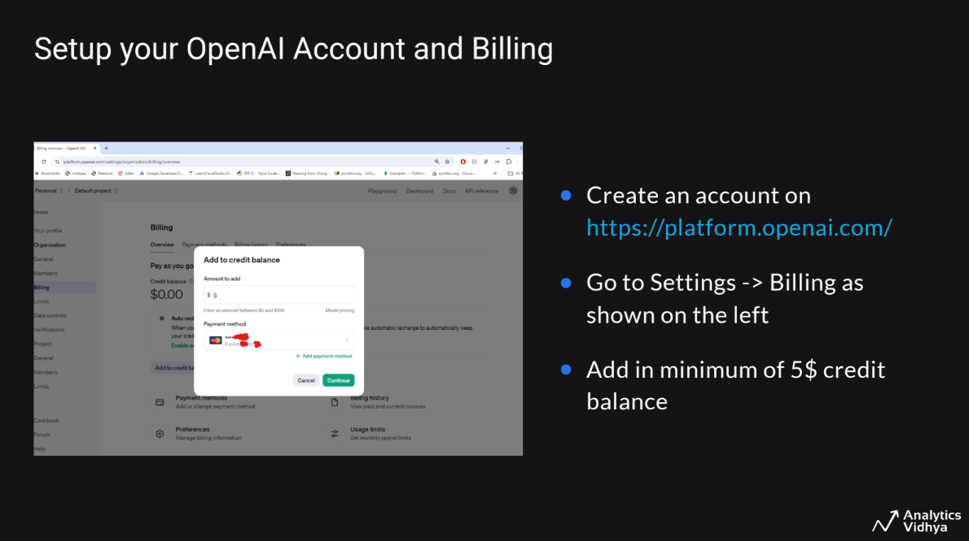

Slide 18
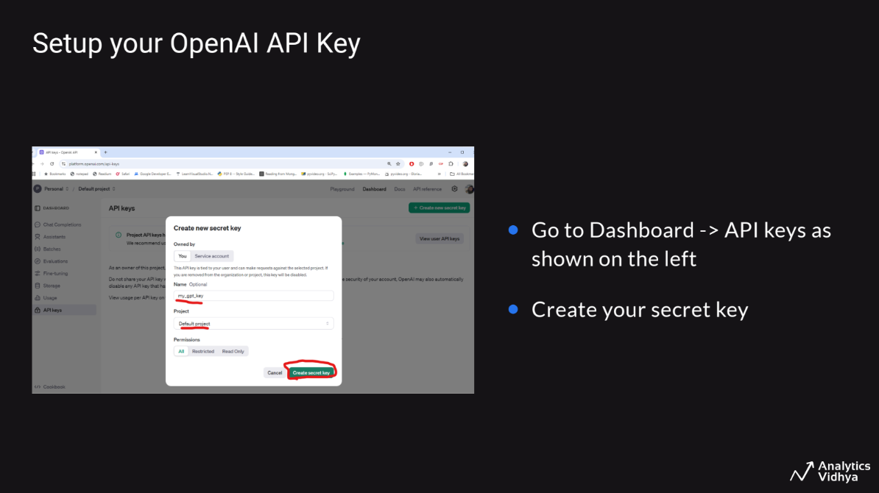

Slide 19
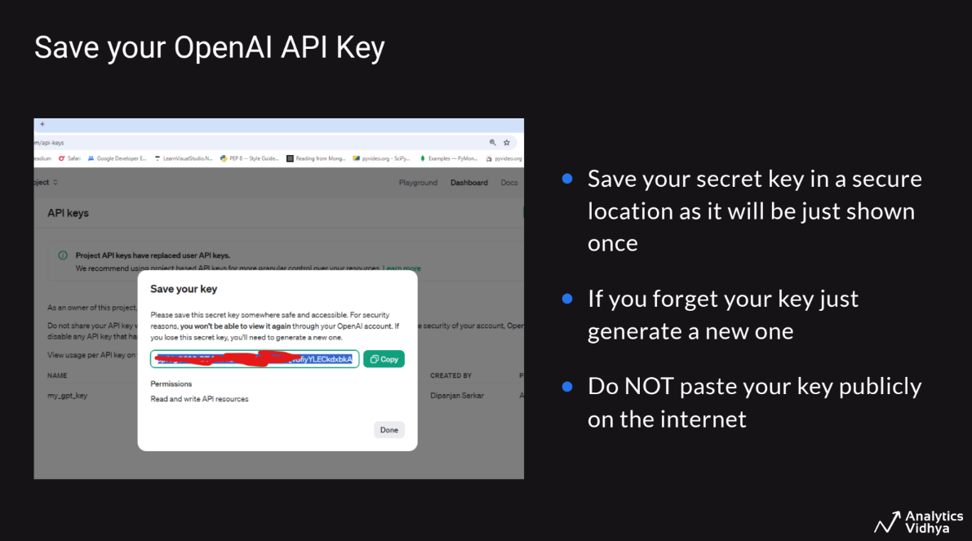

Slide 20
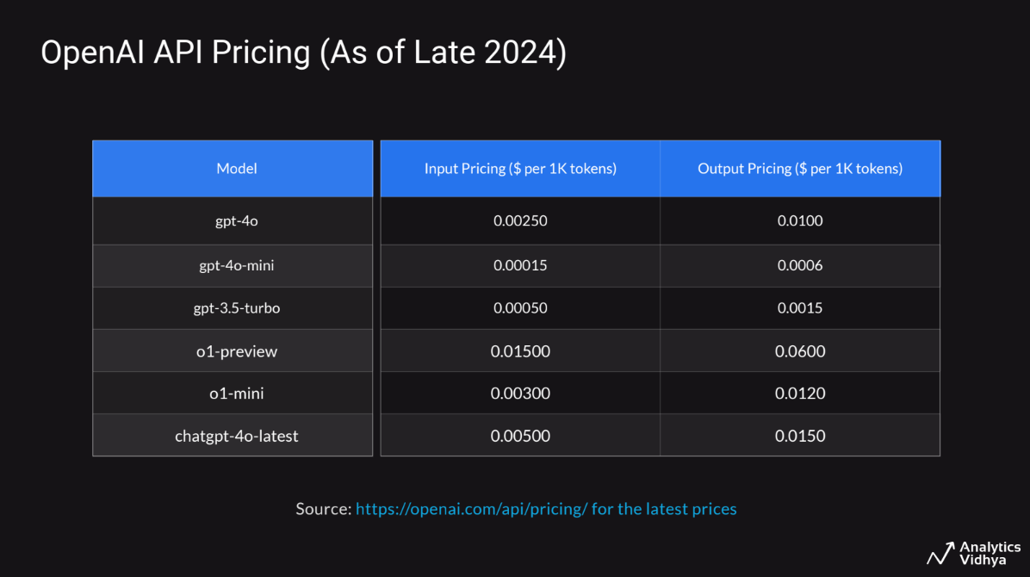

Slide 21
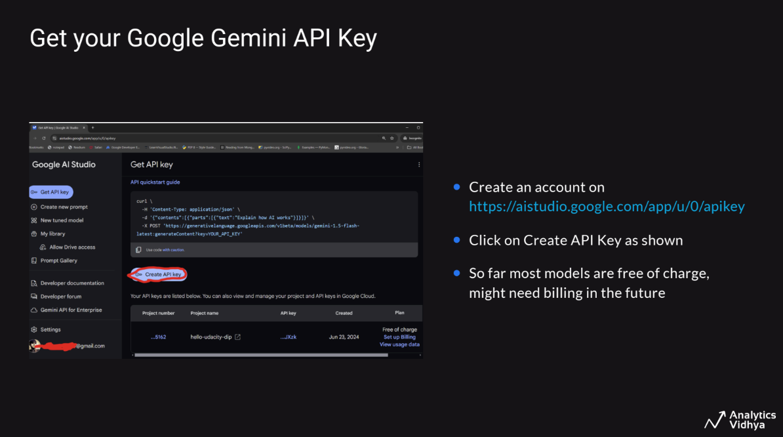

Slide 22
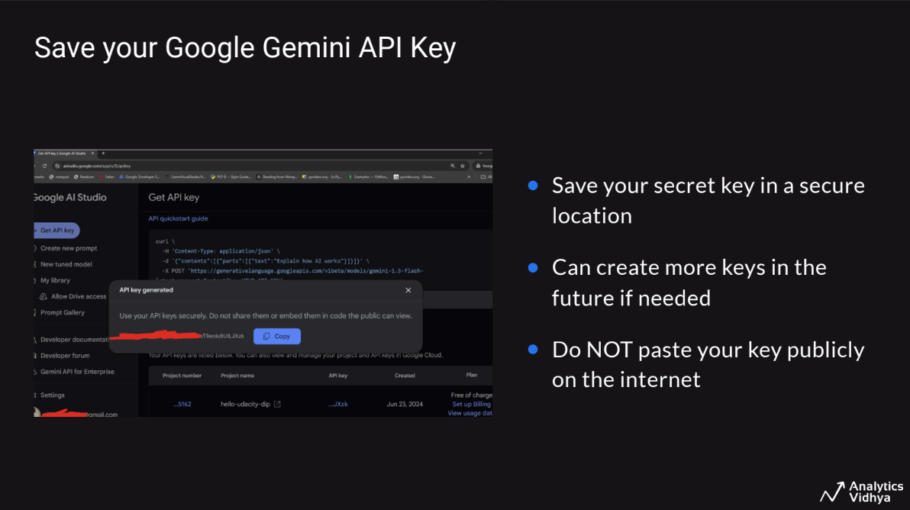

Slide 23
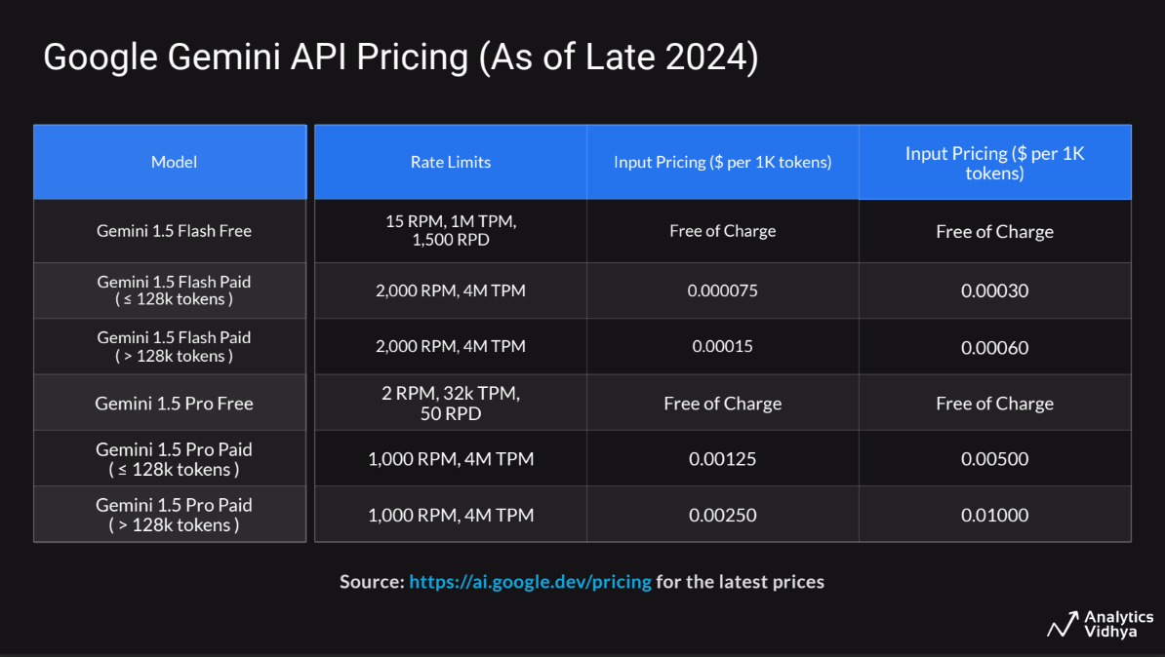

Slide 24

Live Coding - Session 1
Model I/O with LangChain - How to use Commercial LLMs
ChatModels and LLMs
Prompts and Templates
Get the notebook from HERE
Run it on Colab by copying to your drive or local system & follow along with the instructor
Recommended to run on Google Colab

Slide 25
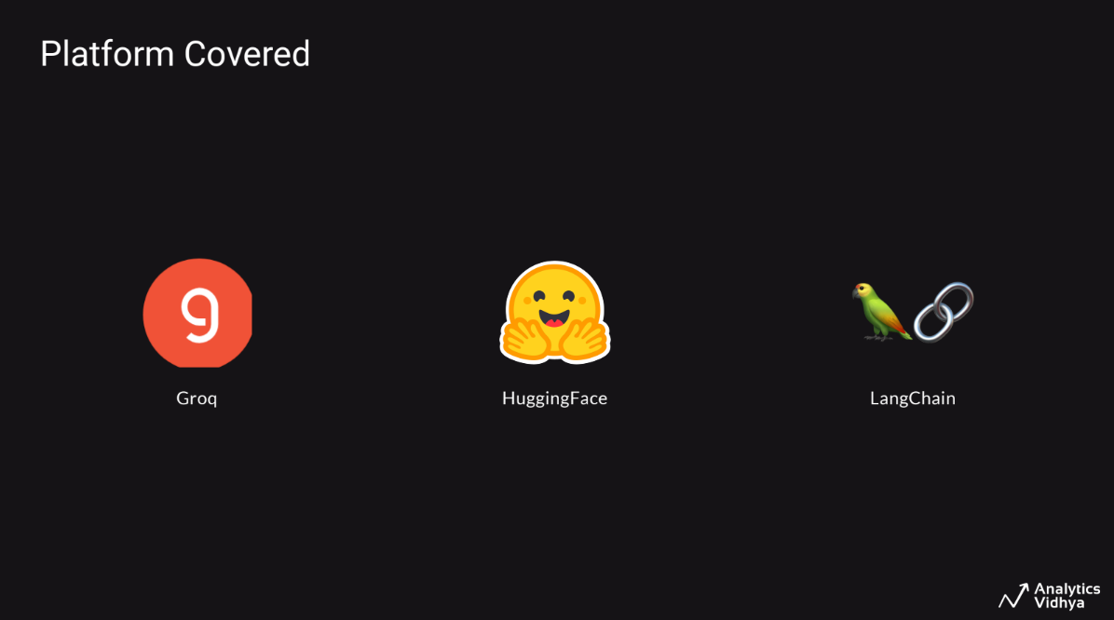

Slide 26
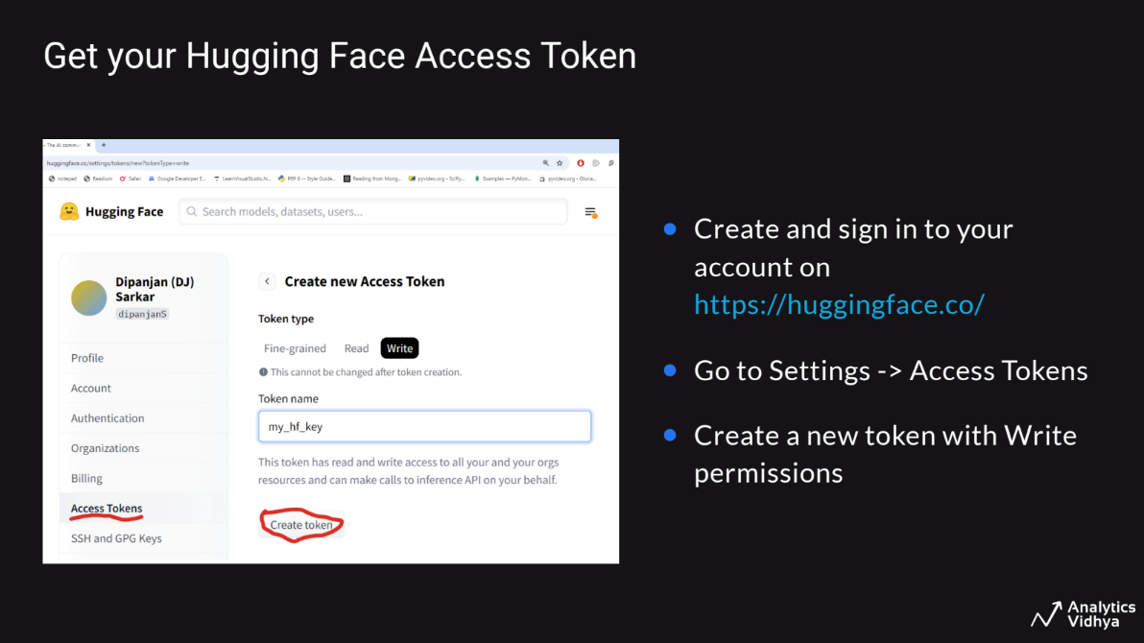

Slide 27
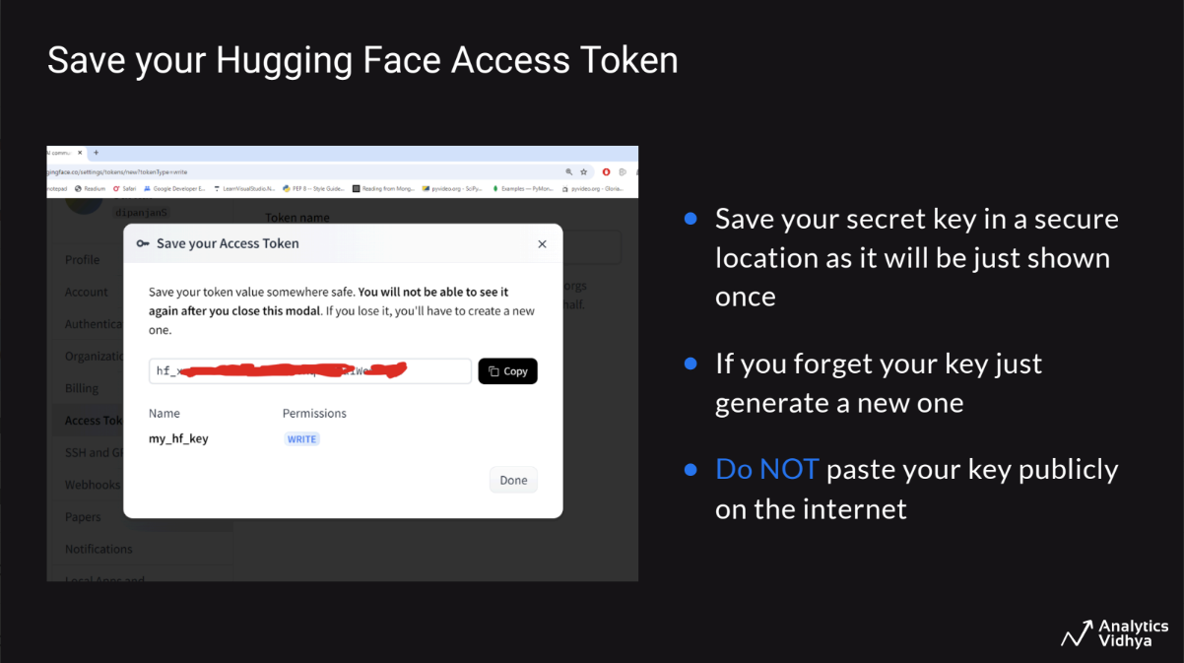

Slide 28
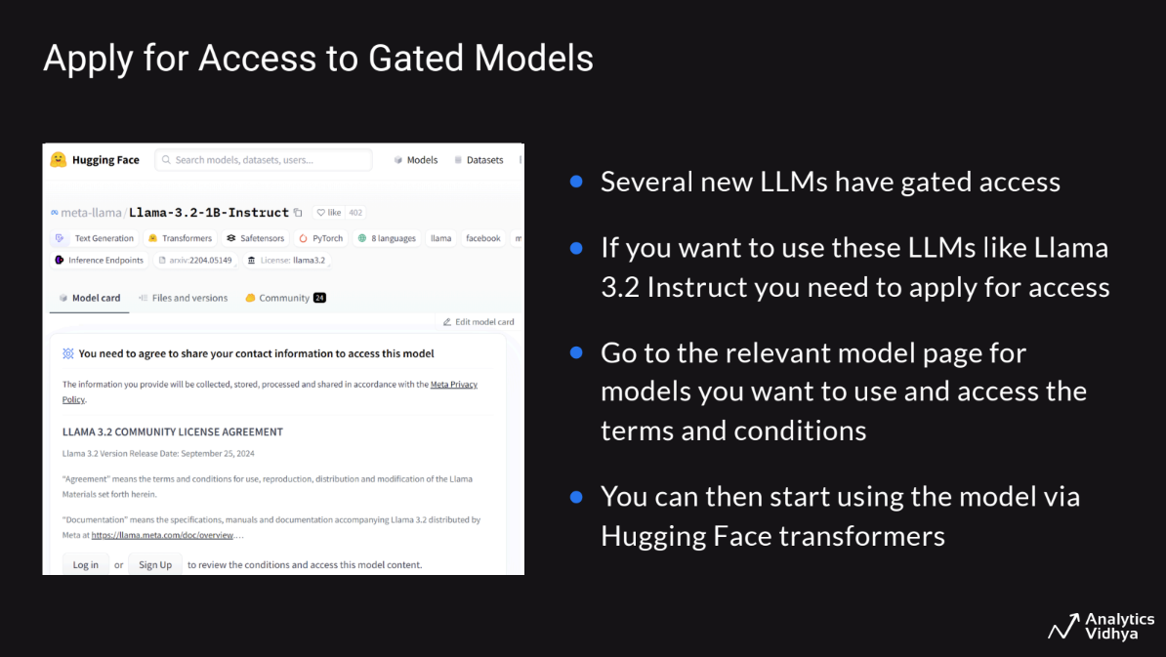

Slide 29
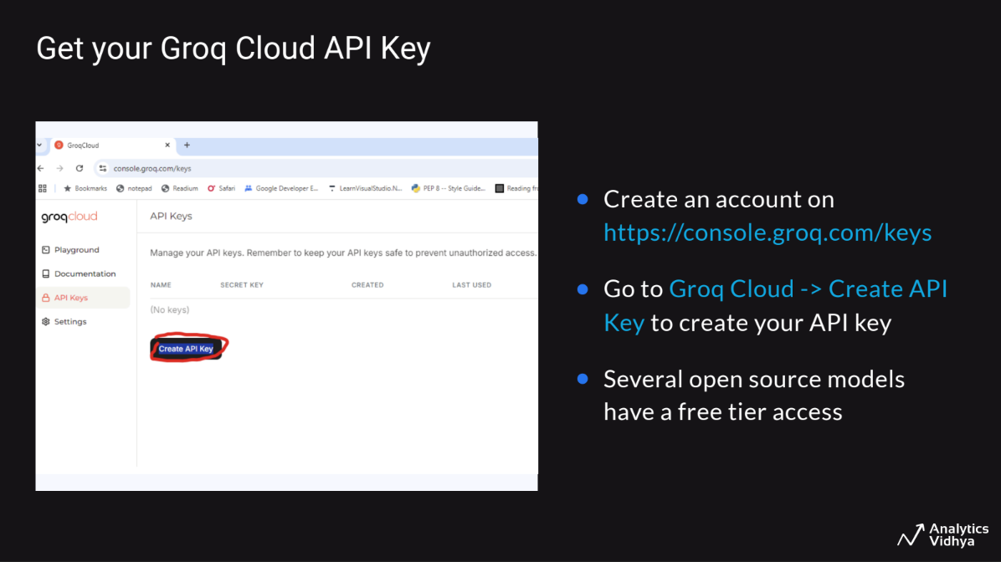

Slide 30
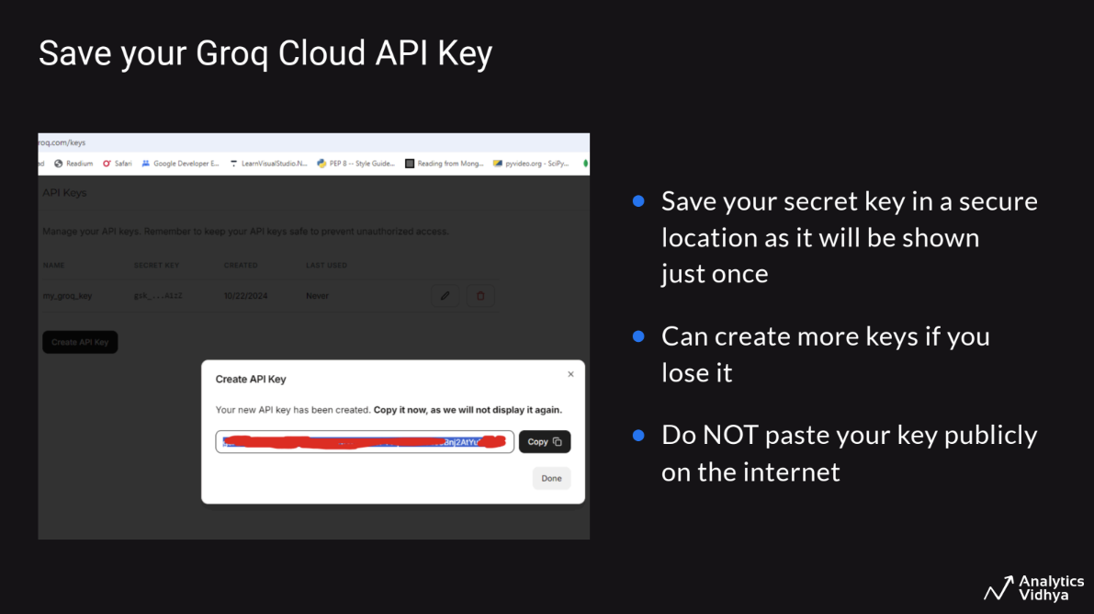

Slide 31
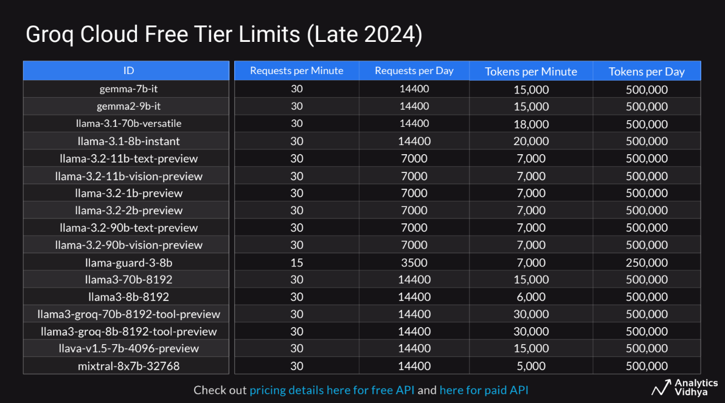

Slide 32
Live Coding - Session 2
Model I/O with LangChain - How to use Commercial LLMs
ChatModels and LLMs
Prompts and Templates
Get the notebook from HERE
Run it on Colab by copying to your drive or local system & follow along with the instructor
Recommended to run on Google Colab

Slide 33
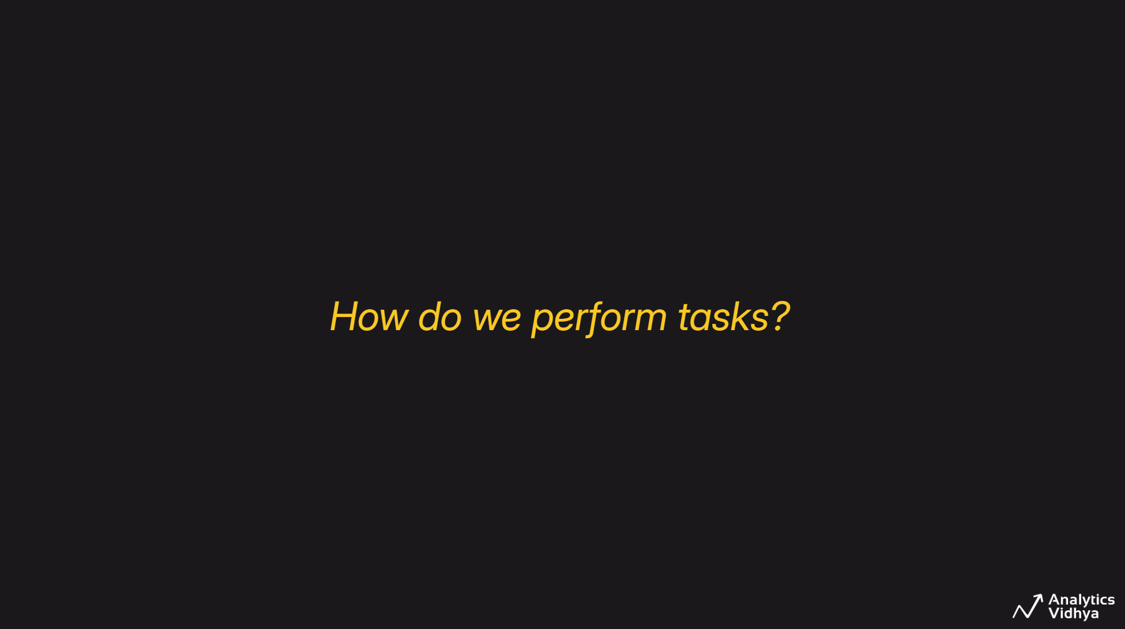

Slide 34
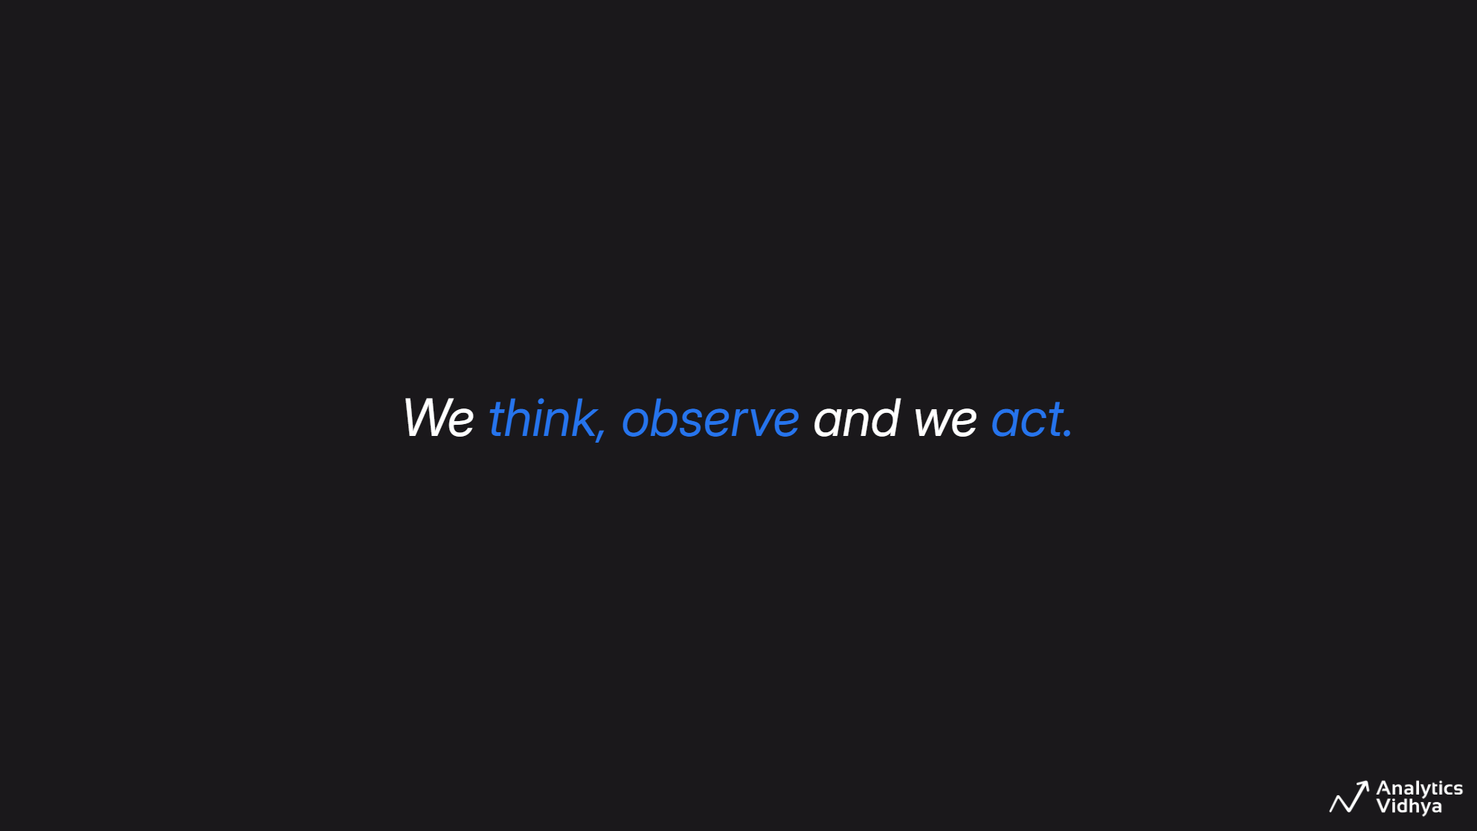

Slide 35
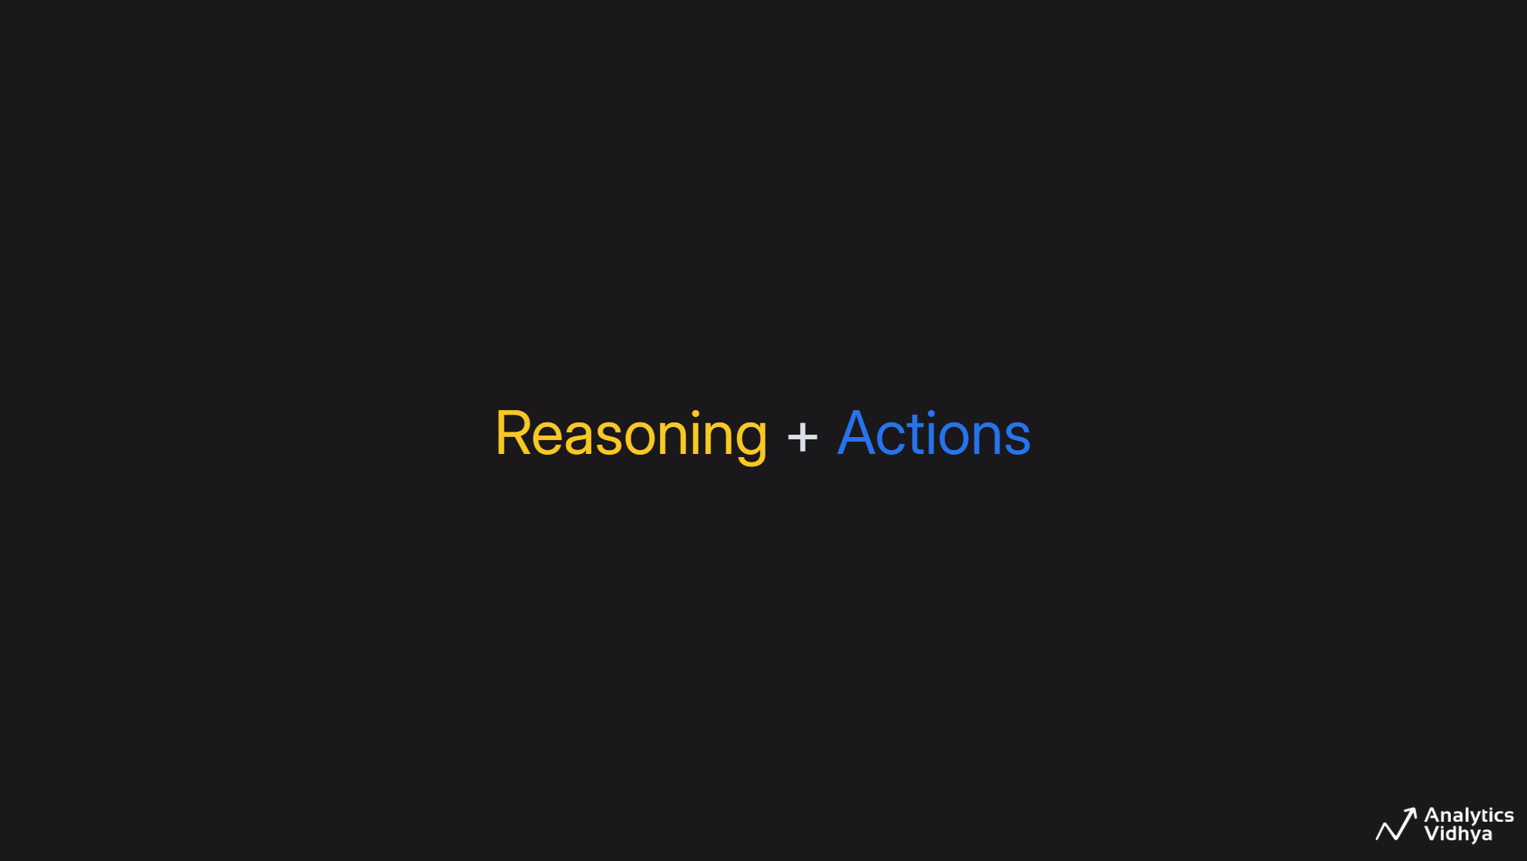

Slide 36
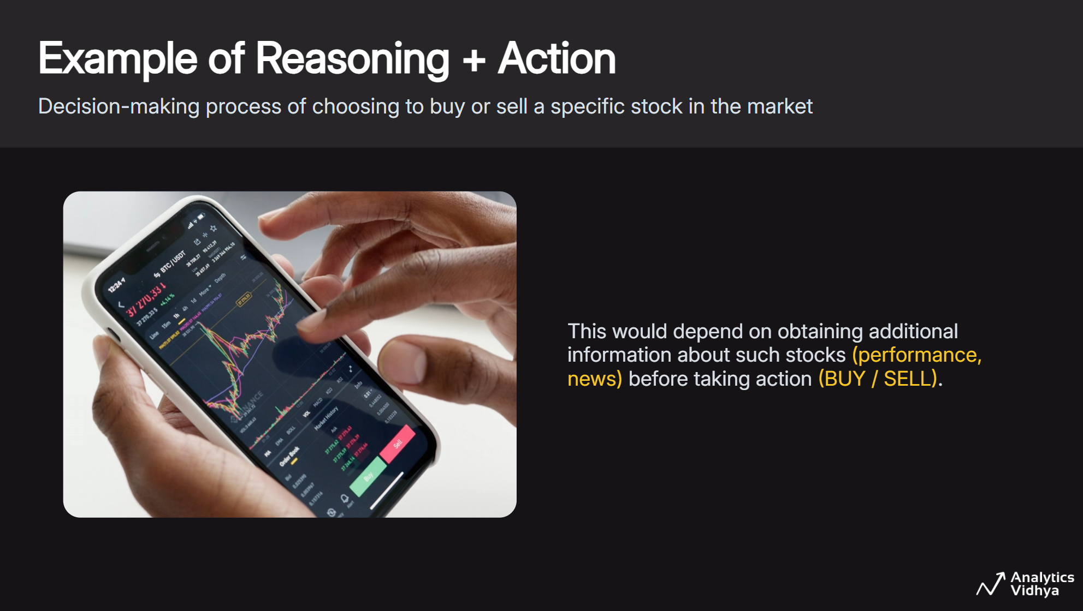

Slide 37
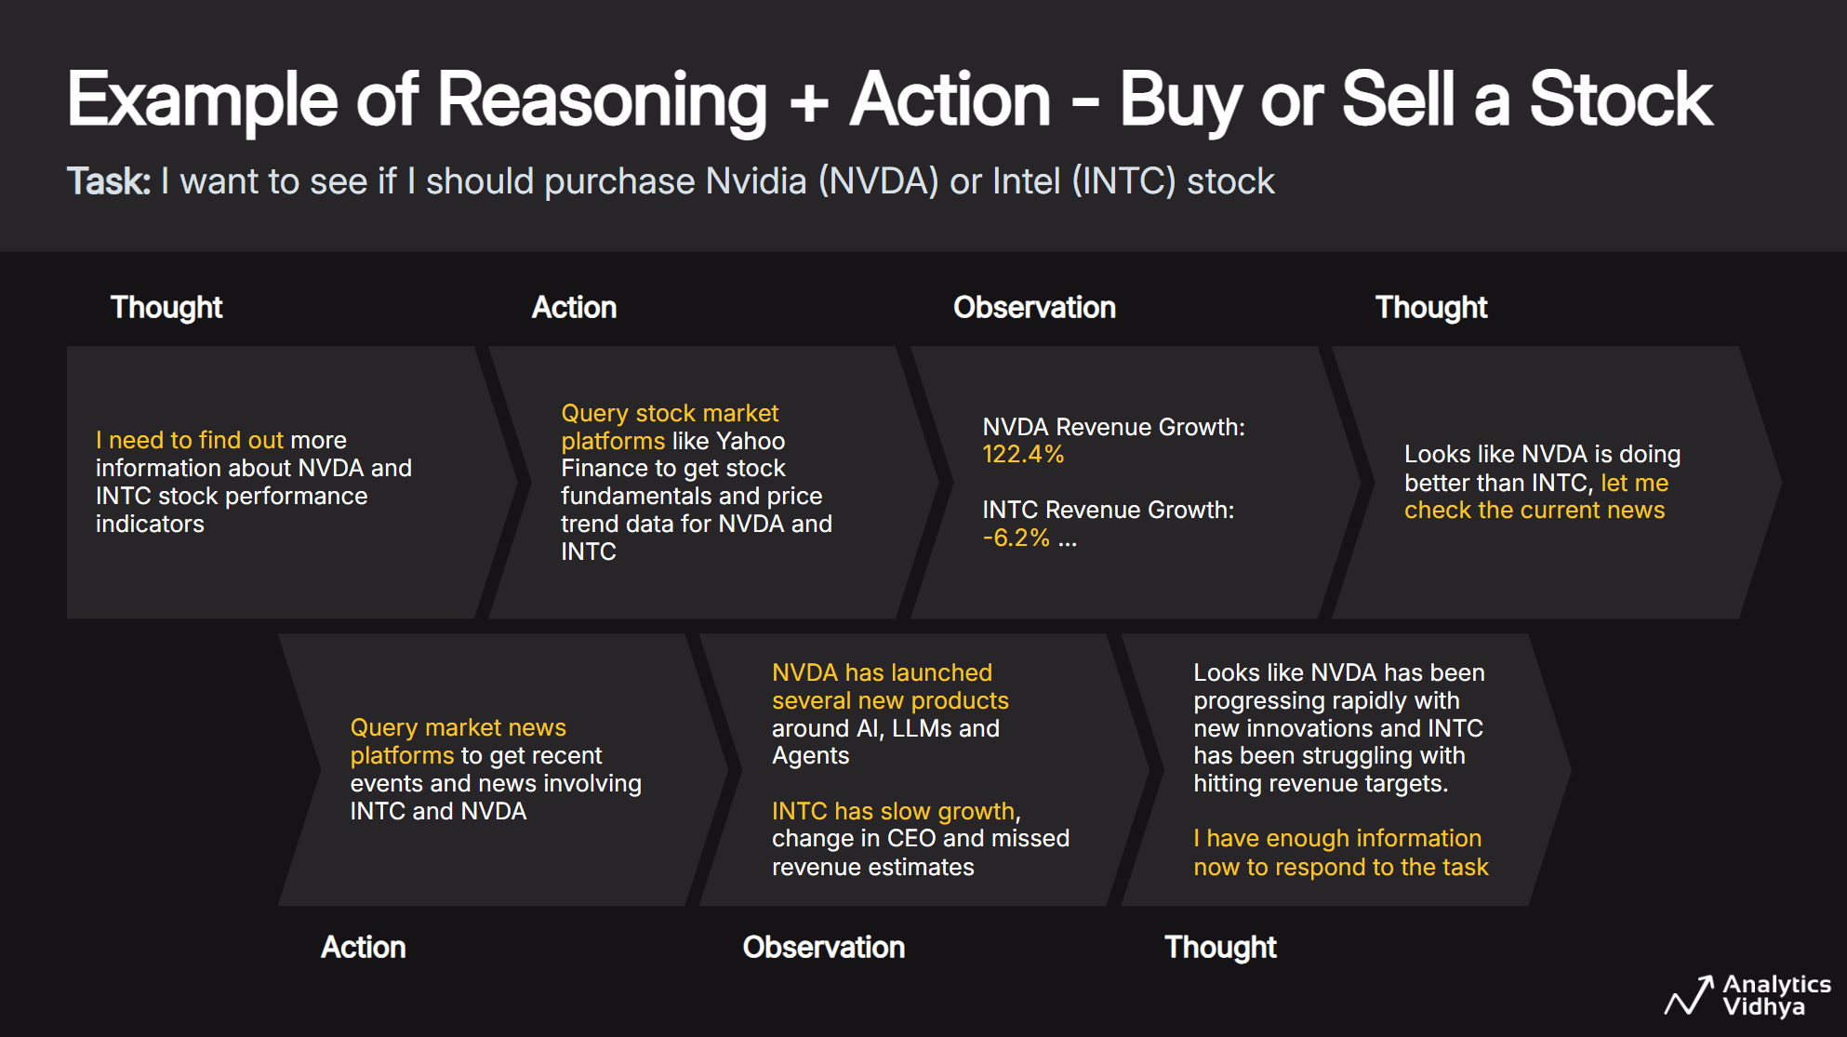

Slide 38
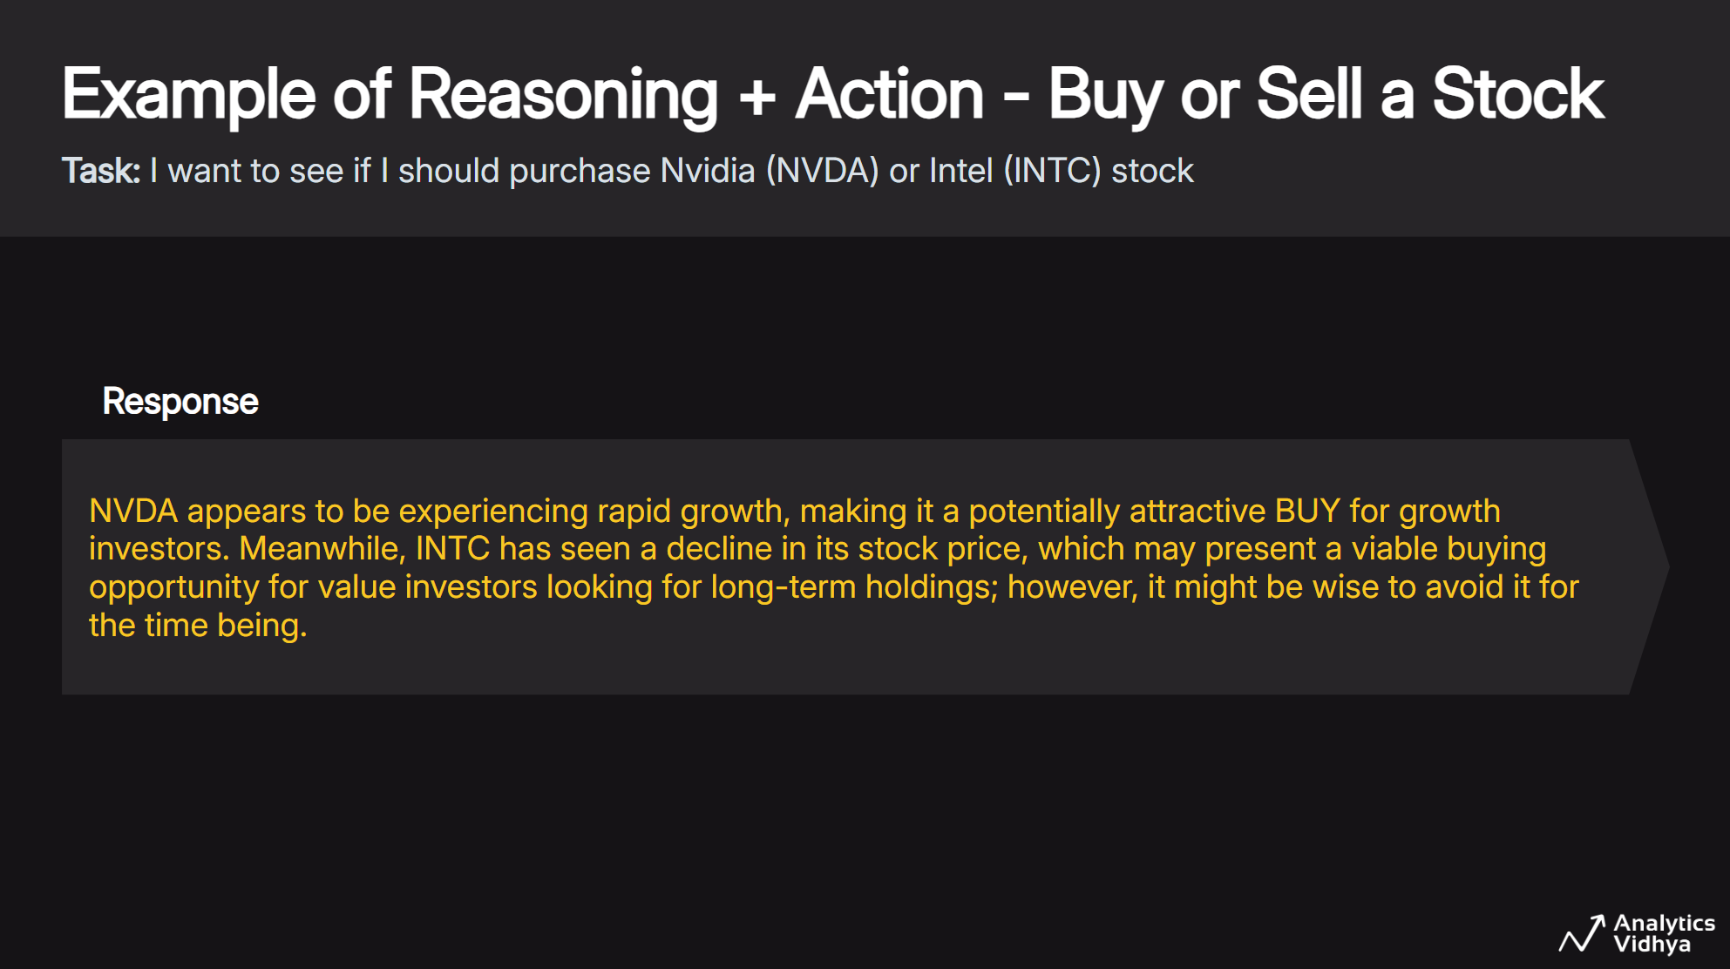

Slide 39
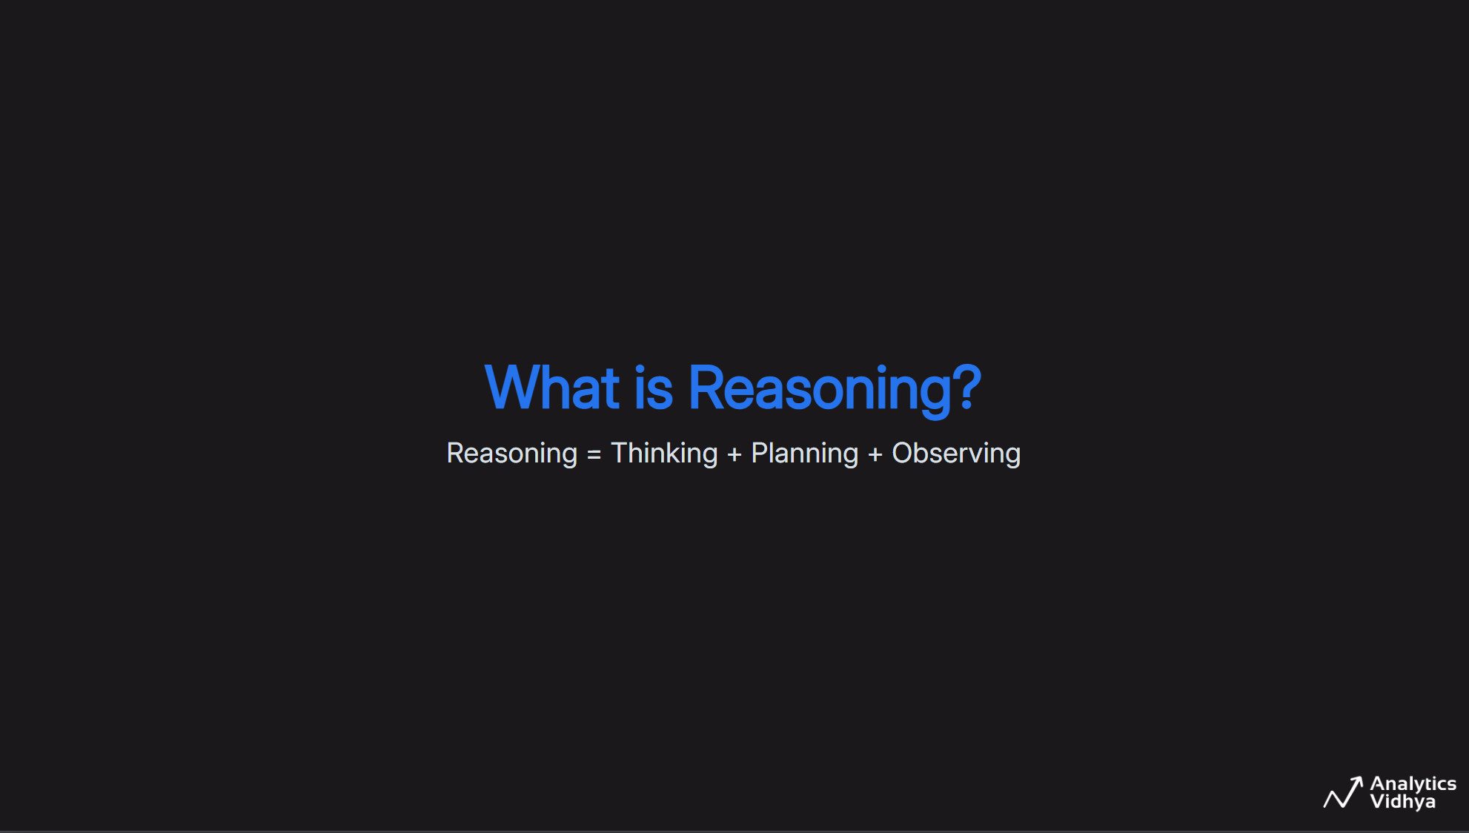

Slide 40
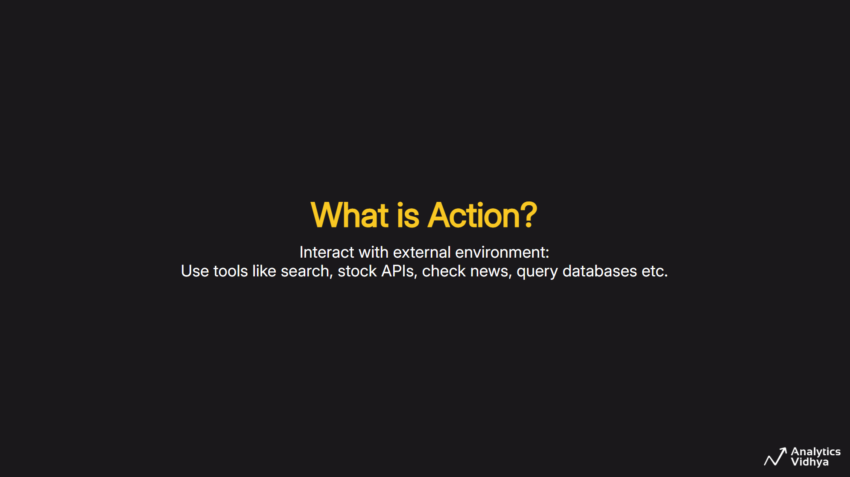

Slide 41
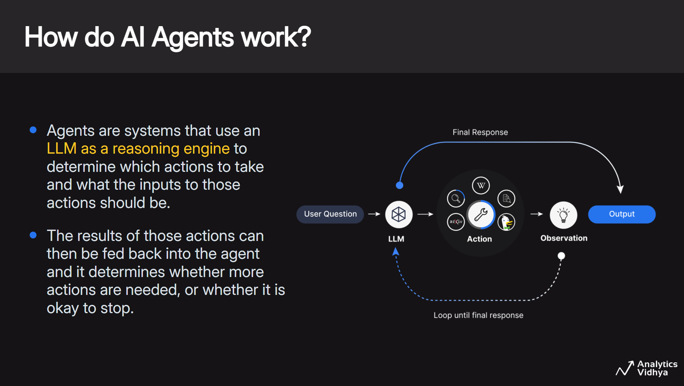

Slide 42
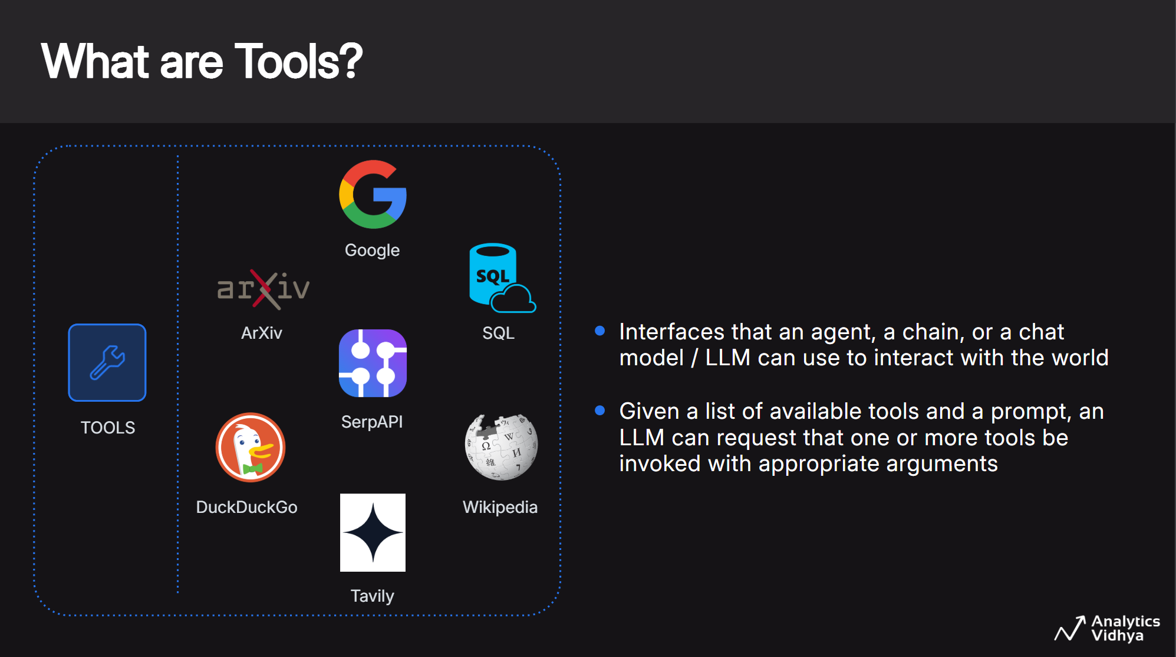

Slide 43
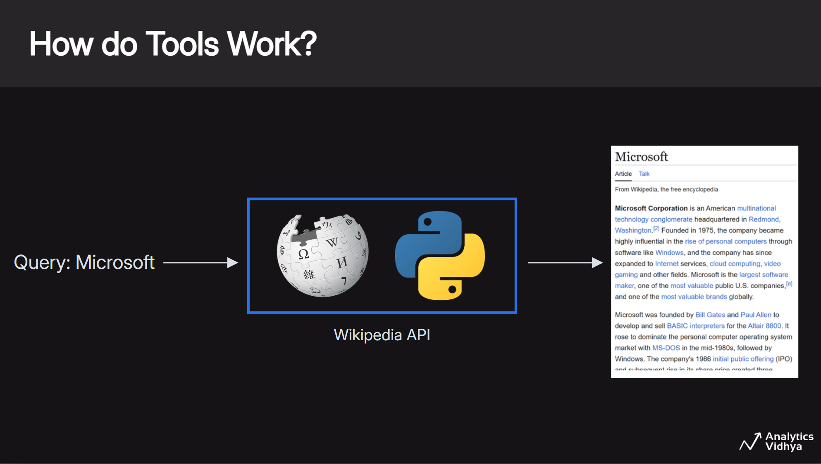

Slide 44
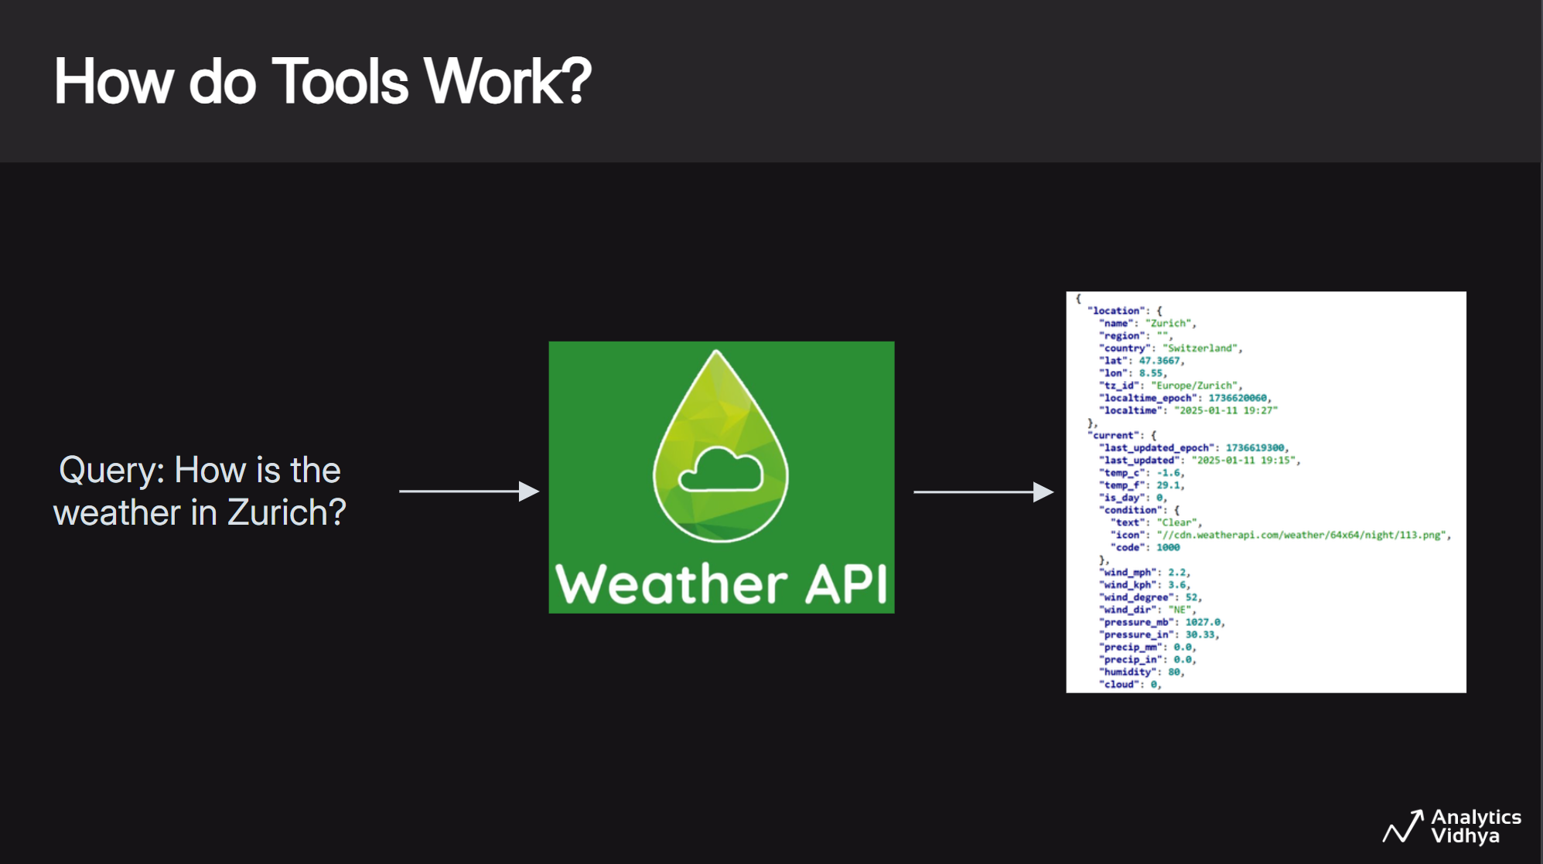

Slide 45
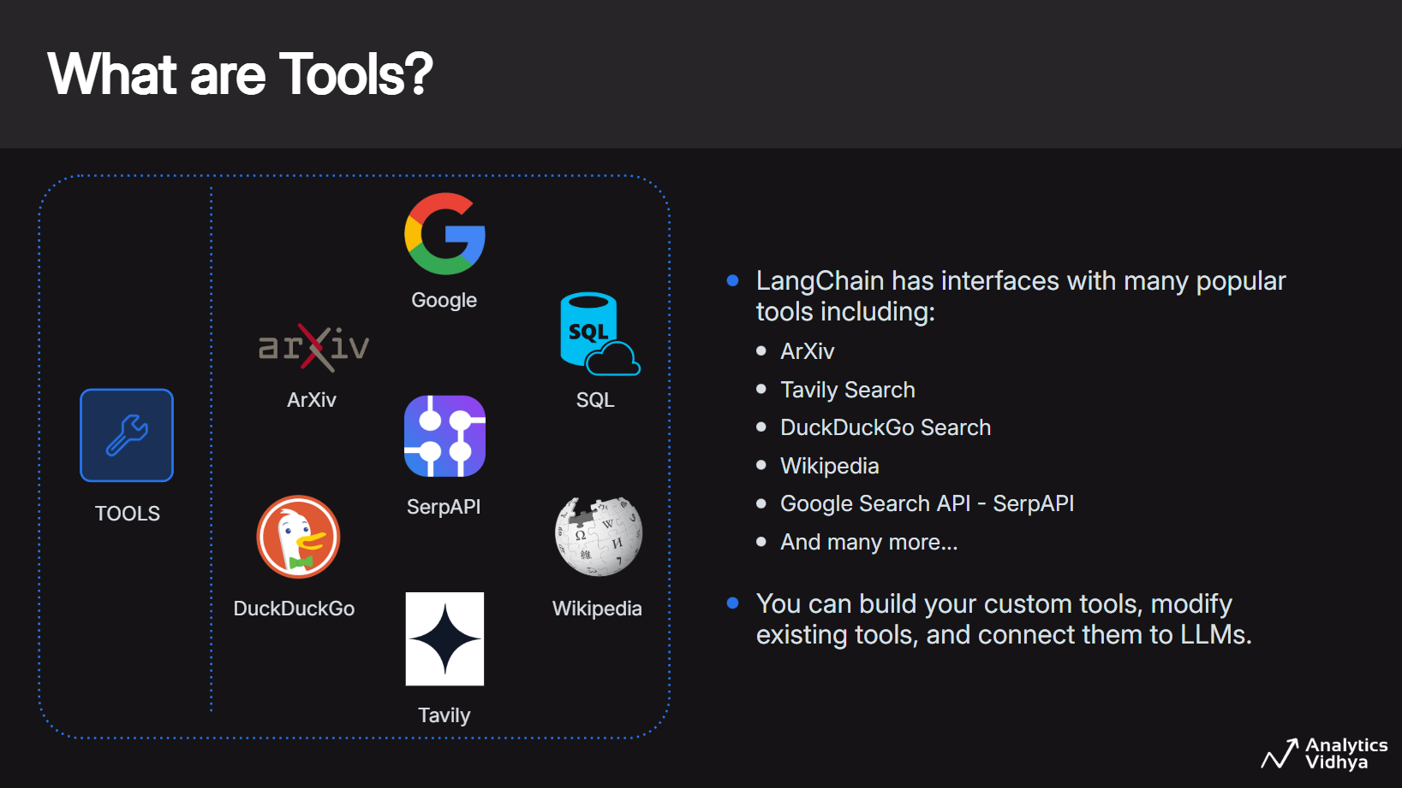

Slide 46
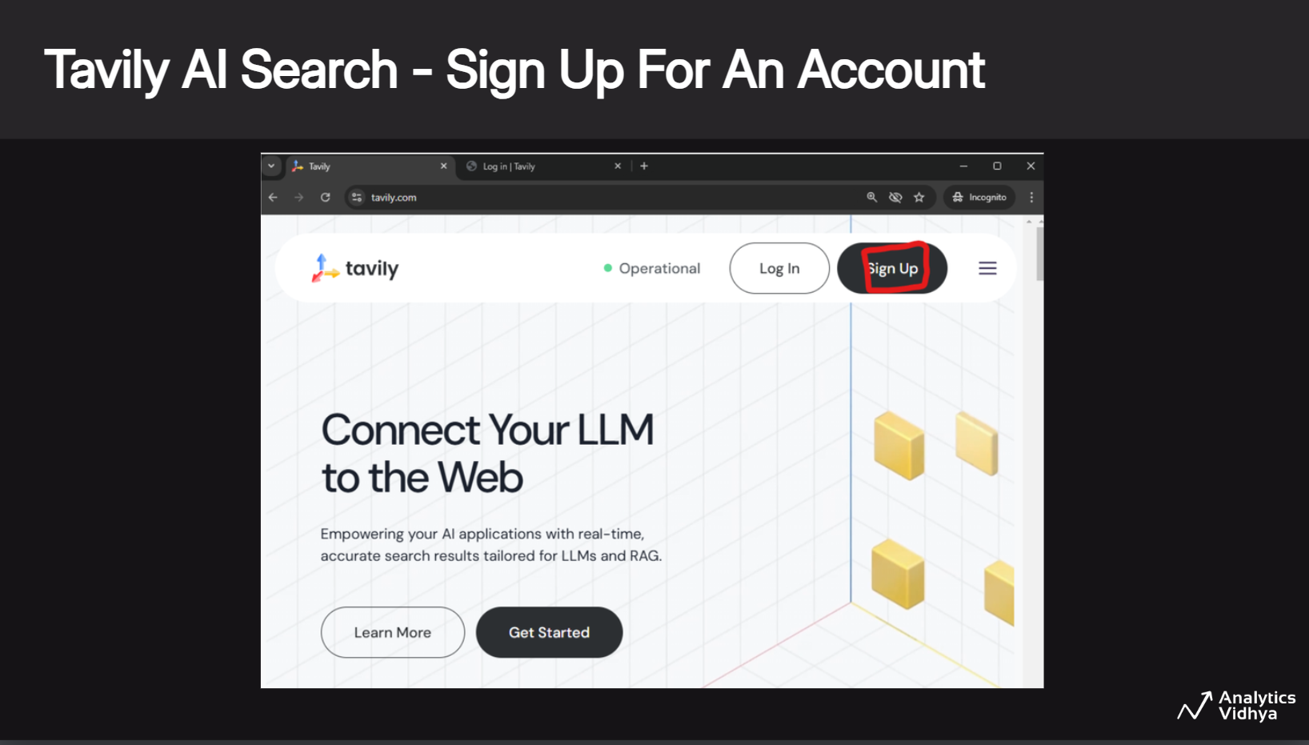

Slide 47
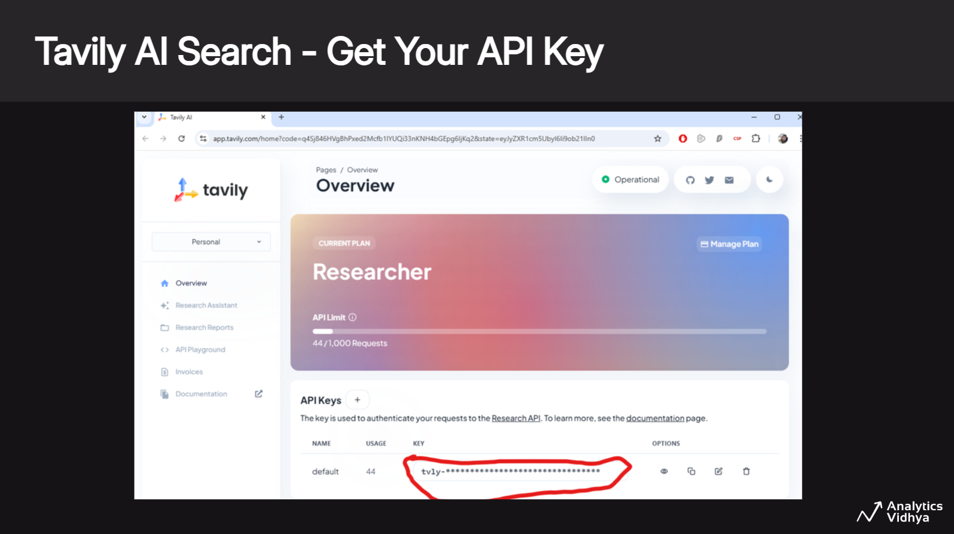

Slide 48
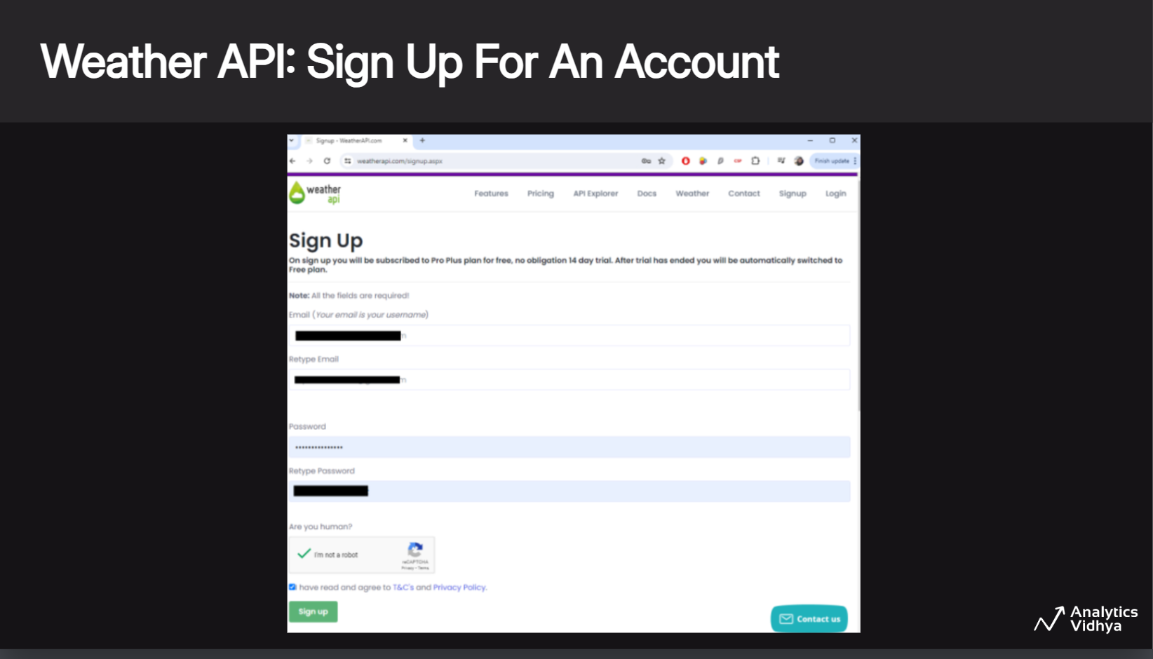

Slide 49
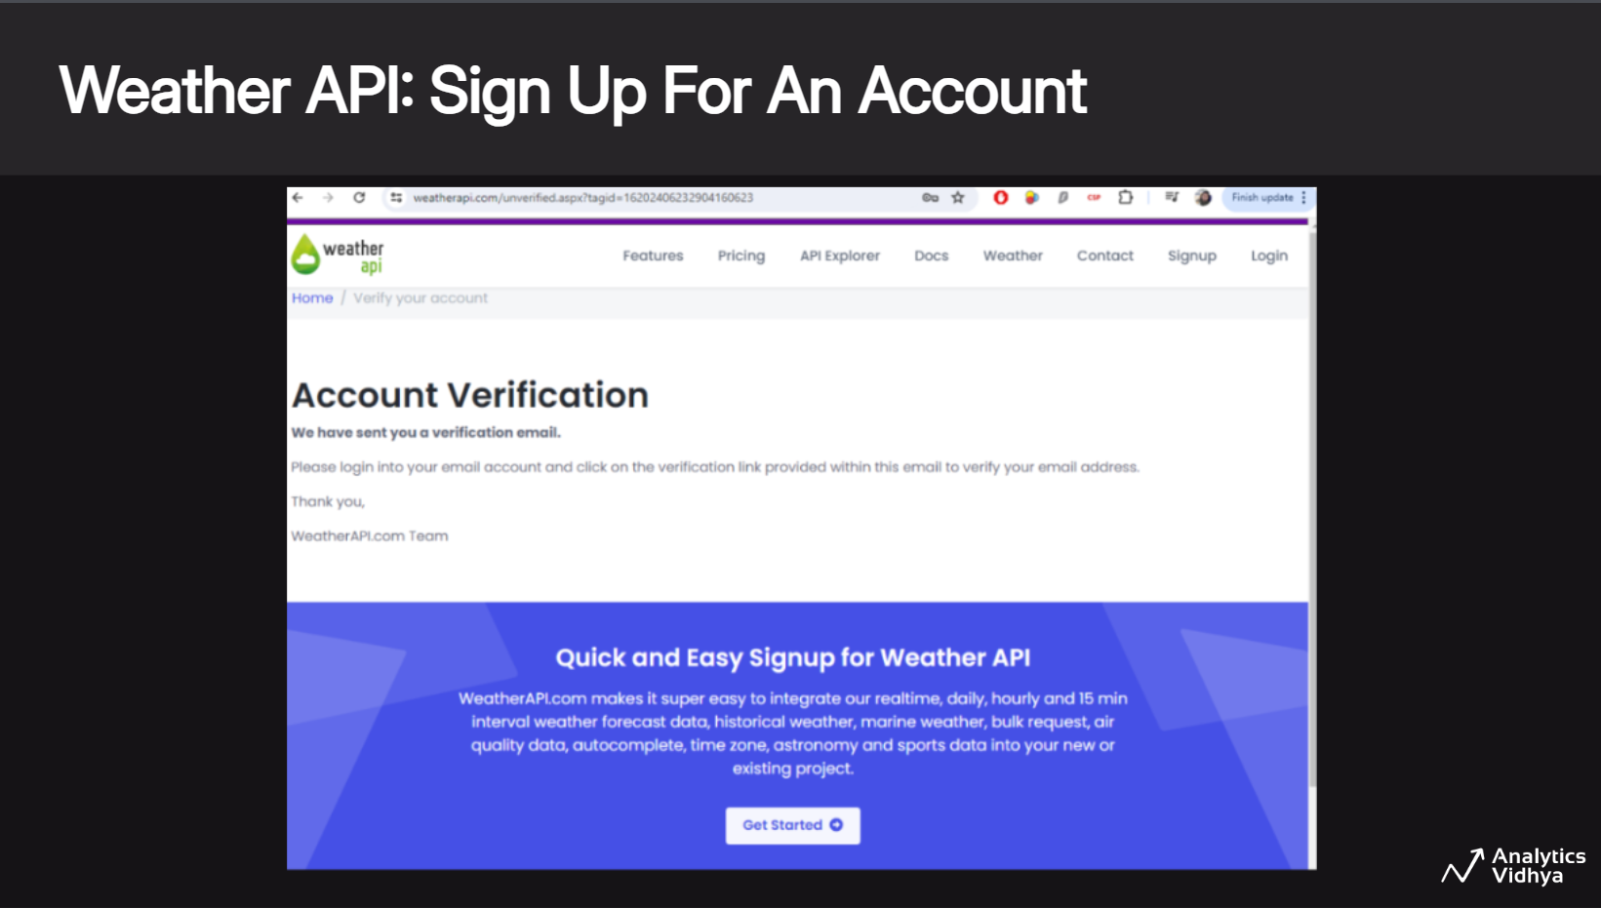

Slide 50
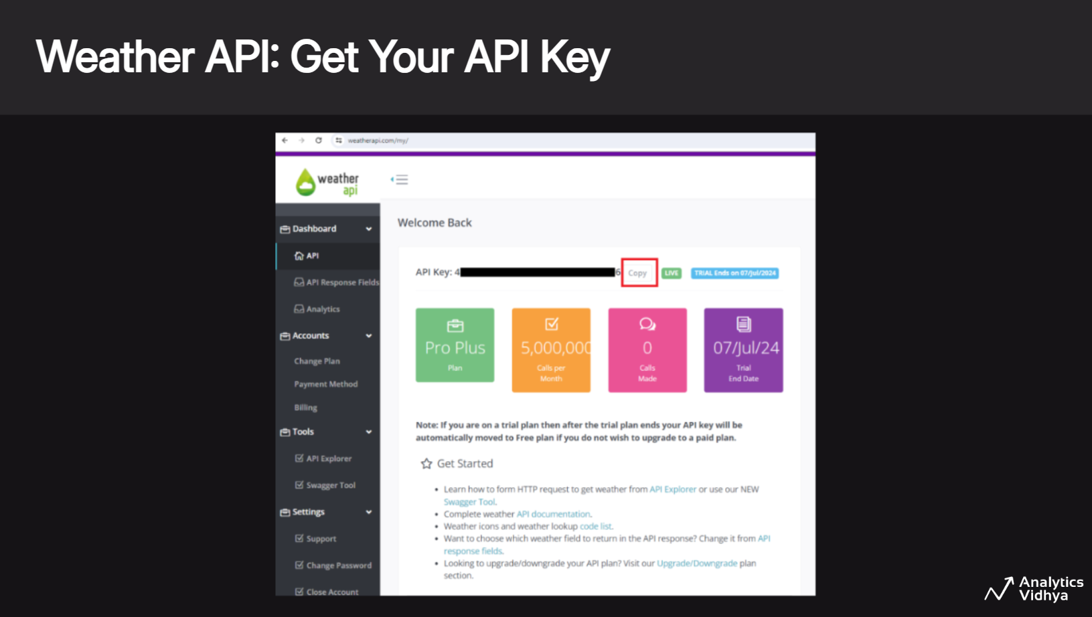

Slide 51
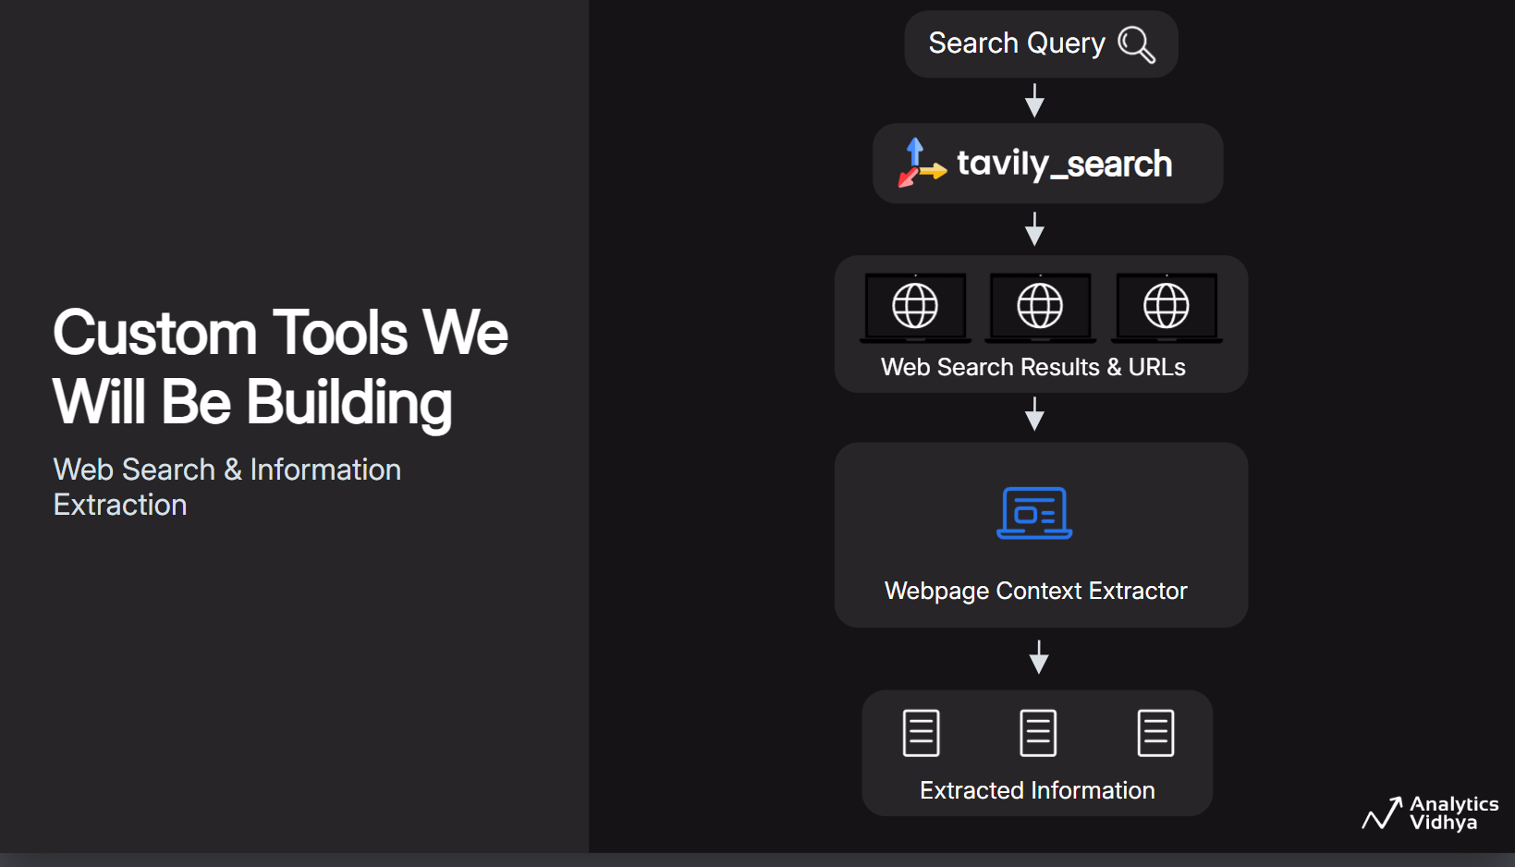

Slide 52
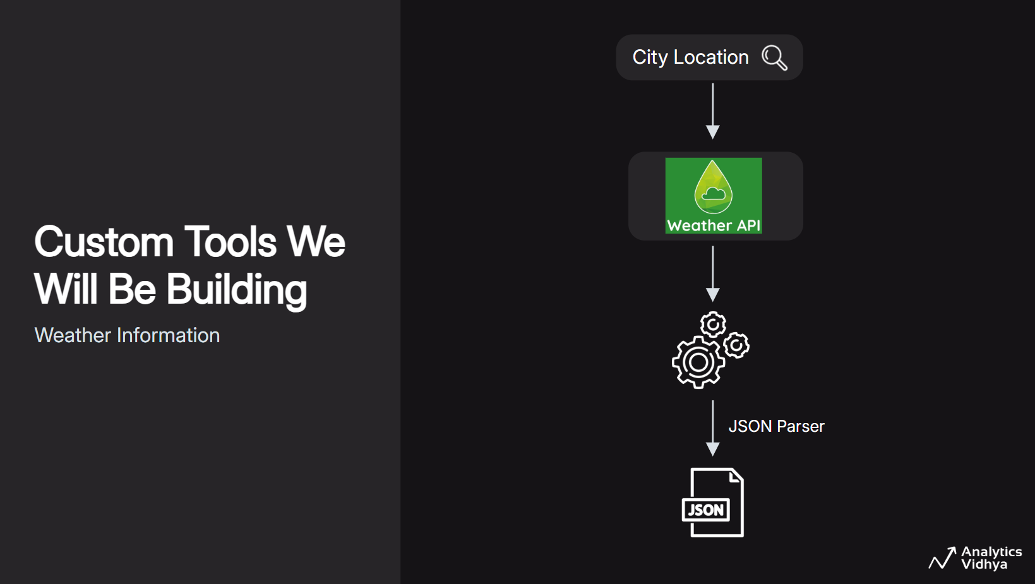

Slide 53


Slide 54


Slide 55


Slide 56


Slide 57


Slide 58


Slide 59
Live Coding - Session 3
Tools and Tool Calling for Agentic AI Systems
Built-in Tools & Creating Tools from Scratch
Tool-Calling or Function Calling with LLMs
Get the notebook from HERE
Run it on Colab by copying to your drive or local system & follow along with the instructor
Recommended to run on Google Colab

Slide 60


Slide 61

Notes:
Various base llms have been developed since the launch of chatgpt by<Click> training on different domain specific datasets, <Click>experimenting with different model architectures, <Click>and scaling the size of the llms, and so on.

Slide 62

Notes:
Various base llms have been developed since the launch of chatgpt by<Click> training on different domain specific datasets, <Click>experimenting with different model architectures, <Click>and scaling the size of the llms, and so on.

Slide 63

Notes:
Various base llms have been developed since the launch of chatgpt by<Click> training on different domain specific datasets, <Click>experimenting with different model architectures, <Click>and scaling the size of the llms, and so on.

Slide 64

Notes:
Various base llms have been developed since the launch of chatgpt by<Click> training on different domain specific datasets, <Click>experimenting with different model architectures, <Click>and scaling the size of the llms, and so on.

Slide 65


Slide 66


Slide 67


Slide 68


Slide 69
Live Coding - Session 4
Build a Tool-Calling Agentic AI Research Assistant
Creating Tools from Scratch
Tool-Calling with LLMs
Connect all components using LangChain’s Tool-calling Agent Framework
Get the notebook from HERE
Run it on Colab by copying to your drive or local system & follow along with the instructor
Recommended to run on Google Colab

Slide 70


Slide 71


Slide 72


Slide 73


Slide 74


Slide 75


Slide 76
Live Coding - Session 5
Build a Multi-User Conversational Tool-Calling Agentic AI Research Assistant
Creating Tools from Scratch
Tool-Calling with LLMs
Connect all components using LangChain’s Tool-calling Agent Framework
Add conversational memory per user-session ID
Get the notebook from HERE
Run it on Colab by copying to your drive or local system & follow along with the instructor
Recommended to run on Google Colab

